Slide 1
Taking Making into Your Schools

Slide 2
Planning your Maker Day

Slide 3
Welcome
The intent of this resource is to assist Organizers using Maker Day Toolkit 2

Slide 4
Introduction
Maker Day Toolkit 2, page 3

Slide 5
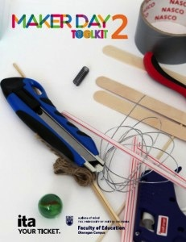
Welcome
Presenter:
Susan Crichton, Director, Innovative Learning Centre (ILC)
Director, Faculty of Education
UBC’s Okanagan Campus
Introduction

Slide 6
conceptualizing a Maker Day
Maker Day Toolkit 2, Pages 6 — 23

Slide 7
Maker Day Concept
Presenter:
Susan Crichton, Director, Innovative Learning Centre (ILC)
Director, Faculty of Education
UBC’s Okanagan Campus
Five
Elements
Conceptualizing, p. 6

Slide 8
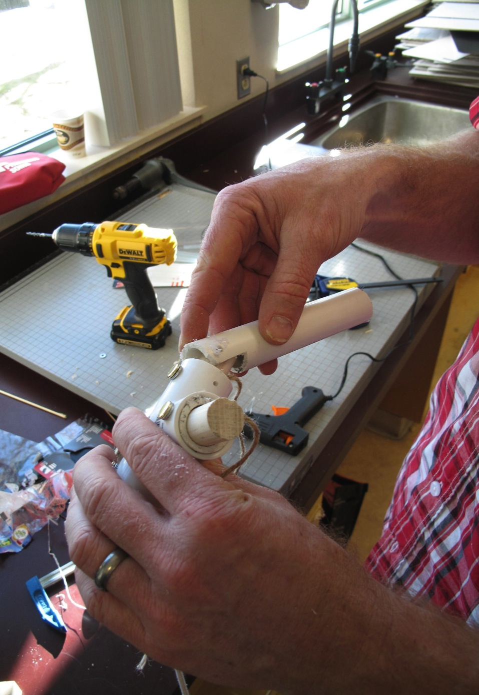
Two Parts to Making
a pedagogical orientation
AND
an intentional mindset
Conceptualizing p. 8-12

Slide 9
Pedagogical orientation
Supporting personalized, constructionist learning
By applying content and skill sets to ‘real world’ design challenges
While integrating curricular competencies (i.e., ADST or STEM_{x} frameworks)
Conceptualizing, p. 8

Slide 10
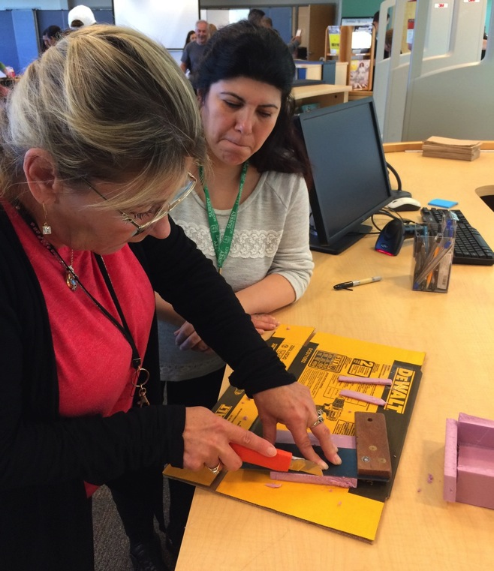
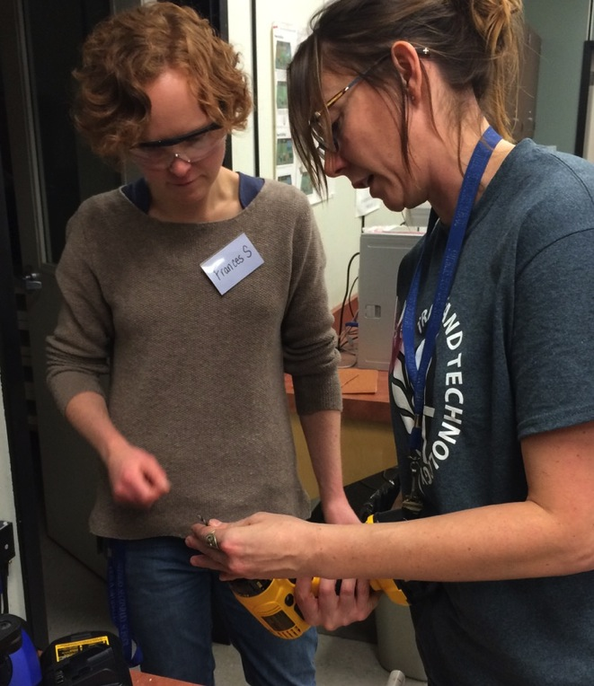
Supporting personalized constructionist learning
Simple Prototyping
Introduction to Fabrication
Conceptualizing, p. 8, 14

Slide 11
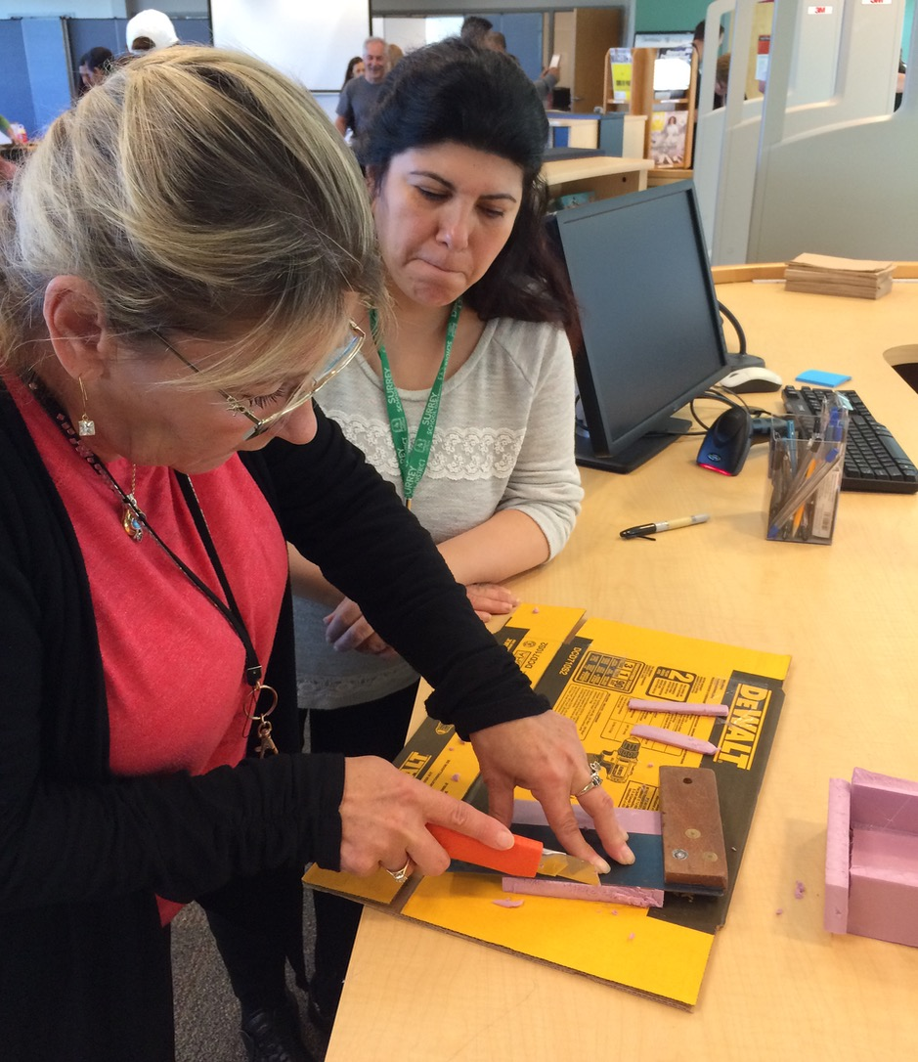
Simple prototyping
Cardboard
Pantry: Recycled Consumables
Tool Station: Simple Hand Tools
Conceptualizing, p. 8, 14

Slide 12
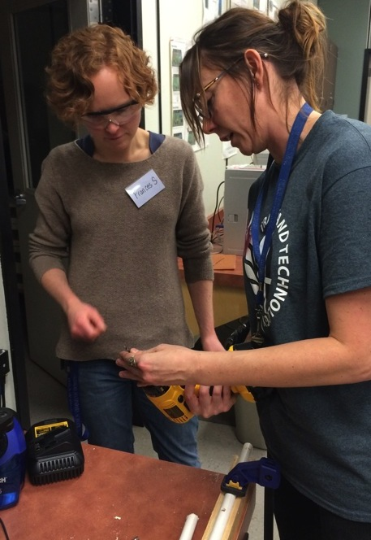
Introduction to fabrication
Adds more robust consumables/tools
Pantry: PVC pipe and Doweling
Tool Crib: Power Tools
Conceptualizing, p. 8, 14

Slide 13
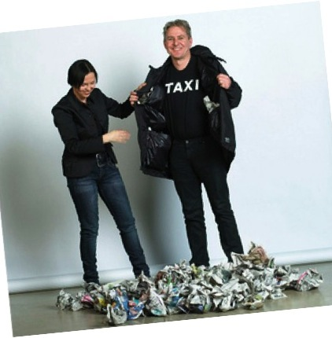

Applying content and skill sets
A well-crafted Design Challenge fosters
Heads-in (content)
Hands-on (skill sets)
Demonstrations of how we know things
Conceptualizing, p. 8

Slide 14
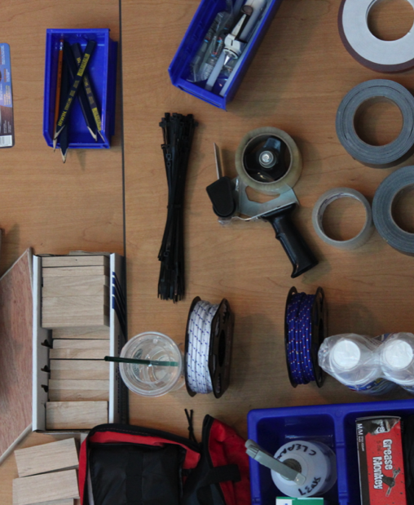
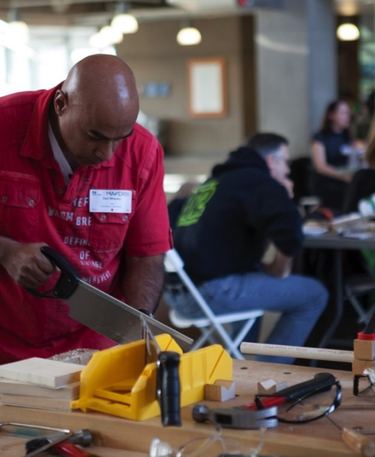
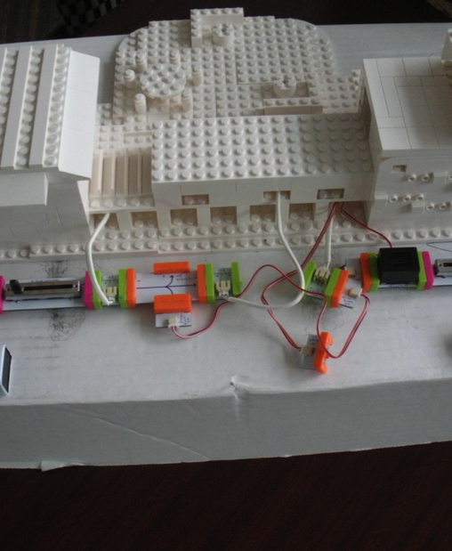
Approaches to challenges
Inquiry Question encourages
exploration of and engagement with the curriculum
Problem Solving introduces
five types
of knowledge: facts, concepts, strategies, procedures and beliefs
Scenarios
helps
visualize context: environment, social, technical, political and economic concerns
Conceptualizing, p.15

Slide 15
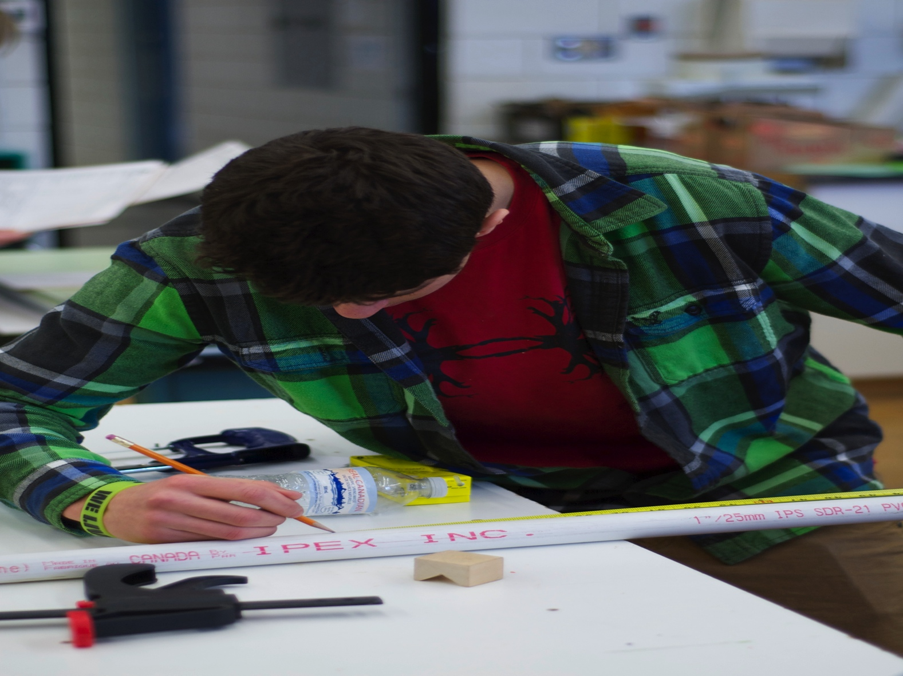
Integrating curricular competencies
Integrated framework examples:
ADST: Applied Design, Skills and Technologies
STEM_{x}: Science, Technologies, Engineering, Mathematics — User Experiences
Conceptualizing, p. 8

Slide 16
Intentional Mindset
Nurturing a flow of innovative and creative thinking
Fueled by curiosity
Supported by ‘thinkering’ — a nimble, lateral and connected thinking
Gained through personal empowerment and agency
Building confidence for risk-taking and exploration
Conceptualizing, pp. 11-12

Slide 17
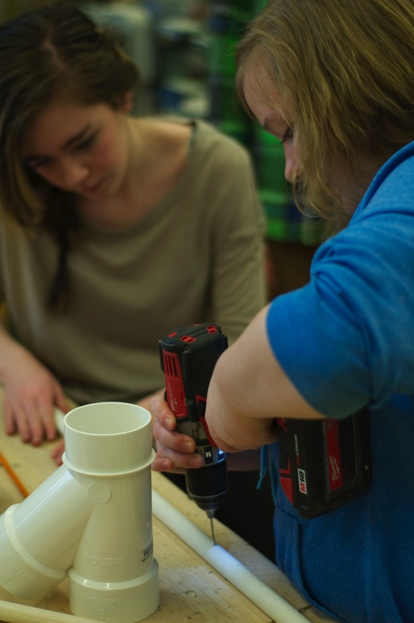
Making a case for making
Presenter:
Susan Crichton, Director, Innovative Learning Centre (ILC)
Director, Faculty of Education
UBC’s Okanagan Campus
Conceptualizing, pp. 6-8

Slide 18
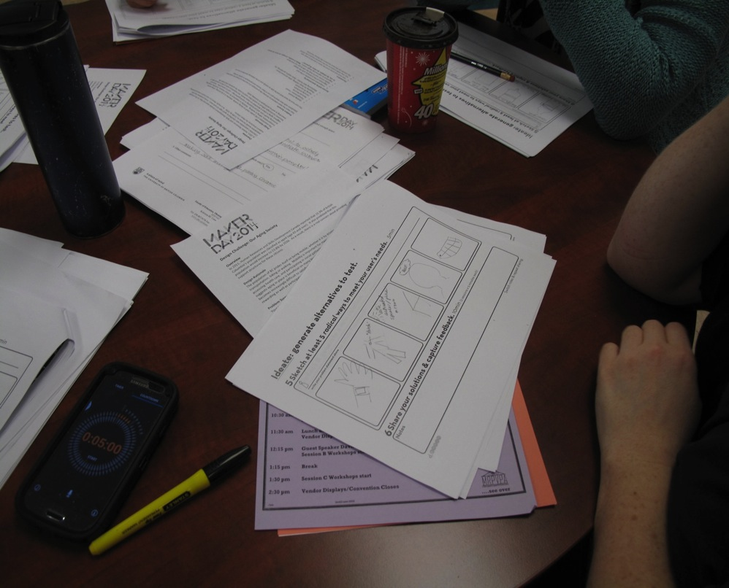
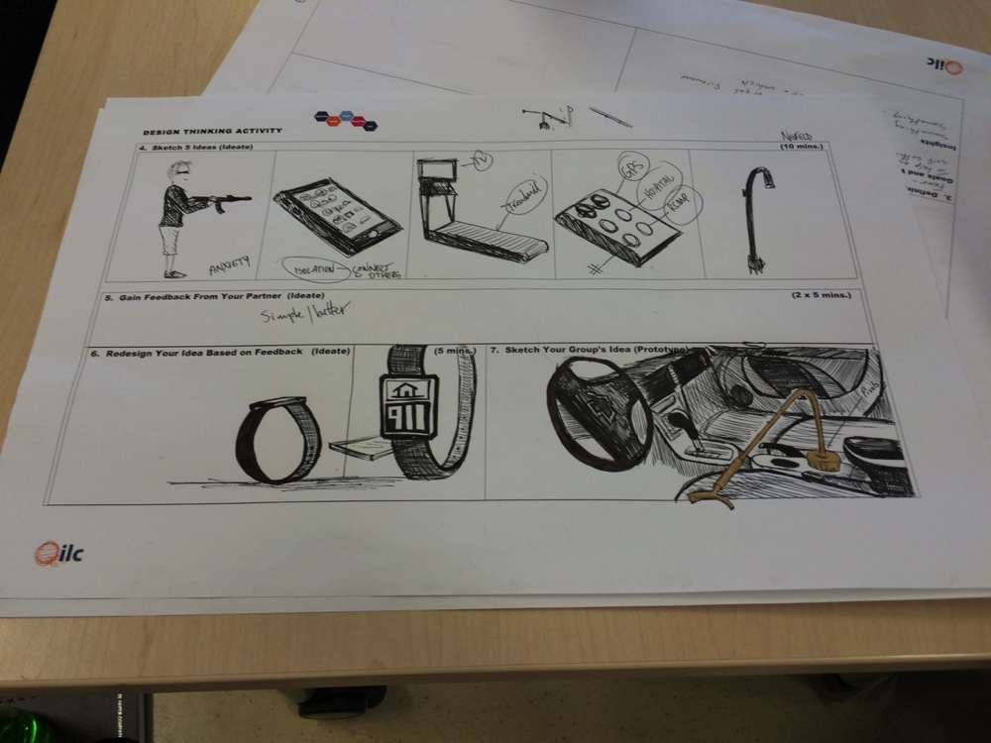
What is Design thinking?
A way of thinking through a series of discussions and negotiations informing the collaborative development of a solution
Conceptualizing, pp. 16-19

Slide 19
Design is optimism
Introduction: Susan Crichton, Director, Innovative Learning Centre (ILC) Director, Faculty of Education UBC’s Okanagan Campus
Presenter: Shane Austin Designer
Conceptualizing, pp. 16-19

Slide 20
Planning a Maker Day
Maker Day Toolkit 2, pages 24—28

Slide 21
Planning for facilitation
Facilitators of the Design Thinking Process and Gallery Tour/Design Charrette …
Plan enough time to go through the updated Word docs, including the Facilitator Guide and Participant Design Activity Sheet, found in Section 3. Hosting (pp. 29-33) and practice with a small group.
The updated Word docs are on the ILC’s Maker Day Toolkit webpage http://innovativelearningcentre.ca/maker-day-tool-kit/
Planning for Facilitating pp. 29-33

Slide 22
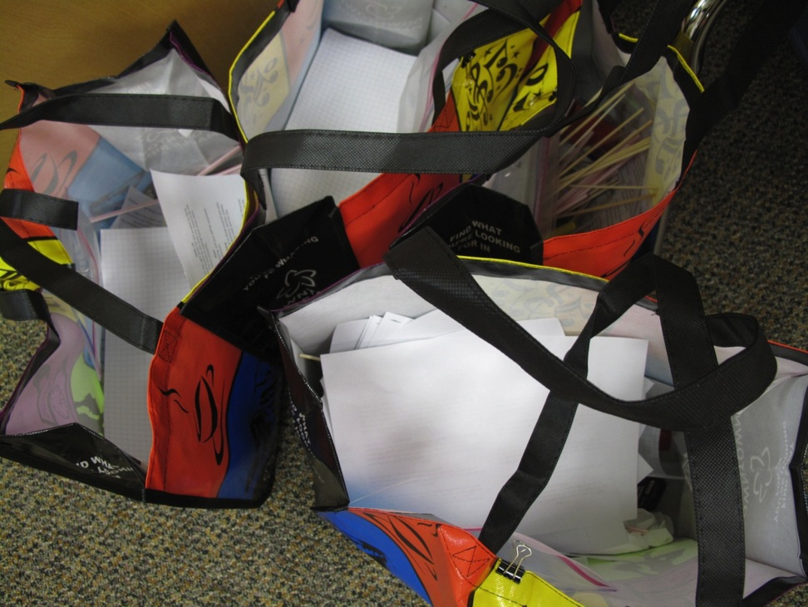
Planning for hosting tips from organizers
Organizers:
Monica, SD54 Buckley Valley
Debbie, SD 60 Peace River North
Zale and Ann, Princess Margaret Secondary School
From the Field

Slide 23
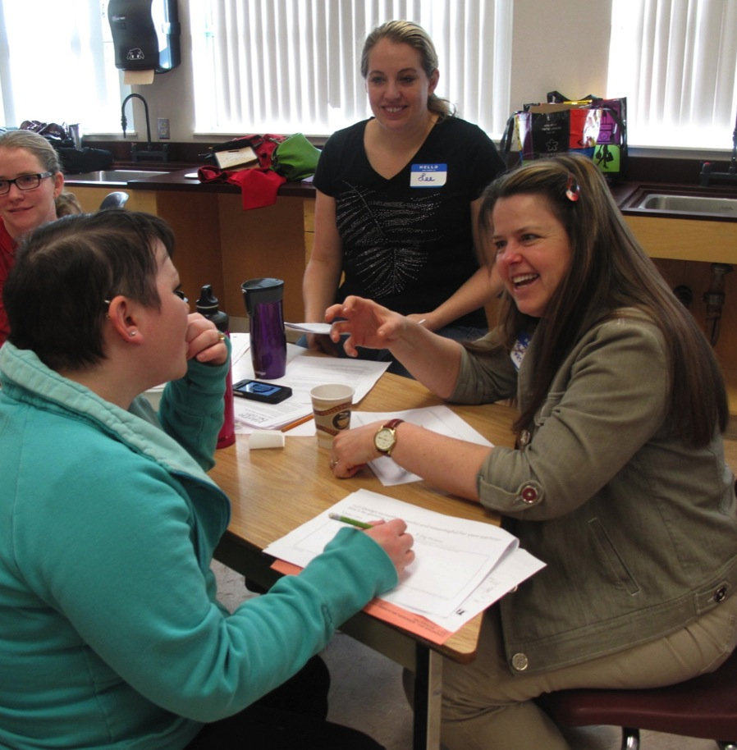
Planning for Hosting Forming groups
Design thinking process requires EVEN numbers in groups
For most Maker Days, attempt to create diverse groups of participants… having community members and teachers from different grades, subjects, schools, etc.
Planning

Slide 24
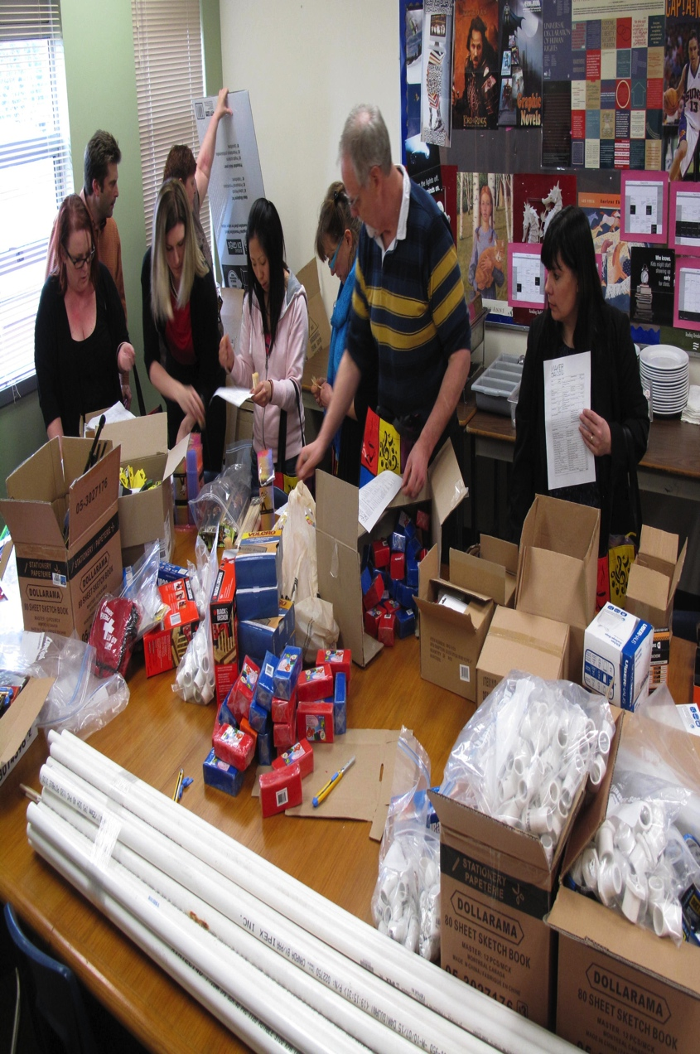
Shopping and Building Participant group kits
Organizers:
Drew and Zale, Princess Margaret Secondary School
Elaine, SD 60 Peace River North
Zale and Ann, Princess Margaret Secondary School
From the Field

Slide 25
Shopping lists
Every Maker Day Shopping List starts with
Tools/Materials for Simple Prototyping
Participant Group Kits
Tool Station
Pantry
Simple Prototyping
Planning
Updated lists are available on the ILC’s Maker Day Toolkit page
http://innovativelearningcentre.ca/maker-day-tool-kit/

Slide 26
Shopping lists
Fabrication requires more Pantry items and
a Tool Crib added to the Simple Prototyping
Participant Group Kits
Tool Station
Pantry
Tool Crib
Introduction to Fabrication
Planning
A Mobile Tool Crib is available on the ILC’s Maker Day Toolkit page
http://innovativelearningcentre.ca/maker-day-tool-kit/

Slide 27
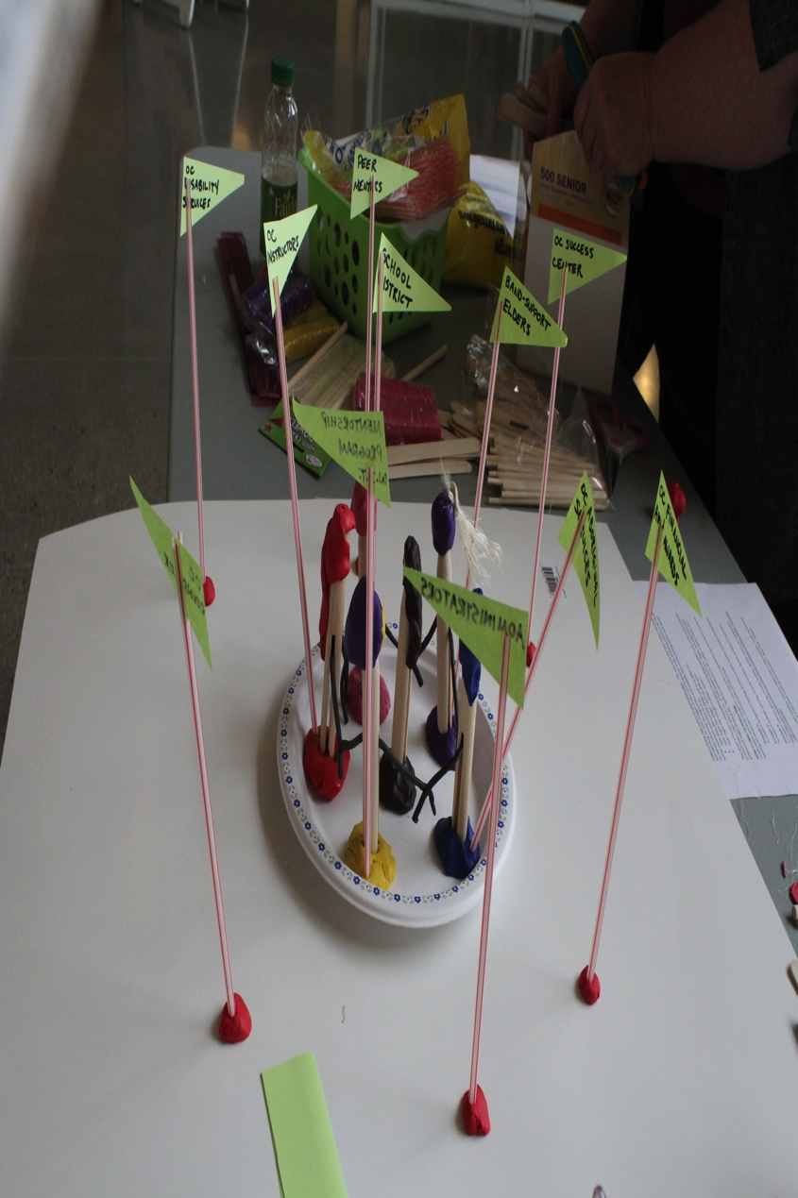
Inviting Community Partners
Presenter:
Susan Crichton, Director, Innovative Learning Centre (ILC)
Director, Faculty of Education
UBC’s Okanagan Campus
Planning

Slide 28

Copying for Design thinking process
Design Challenge Rule of Thumb: 1 copy per 2 participants
Design Activity Sheet 1 double-sided copy per 1 participant
Planning
Some organizers include an Evaluation — an example at
http://innovativelearningcentre.ca/maker-day-tool-kit/

Slide 29
hosting a Maker Day
Pages 29 — 39

Slide 30
Hosting and facilitating your maker day
Presenter:
Susan Crichton, Director, Innovative Learning Centre (ILC)
Director, Faculty of Education
UBC’s Okanagan Campus
Hosting, pp. 40-41

Slide 31
Design charrette presentation
Problem Scenario:
Your team has been selected to look at sustainability issues in your region. Your team must choose an issue that resonates with you and develop a prototype to address the concerns raised by that issue. The issue that you choose should have an impact on the day-to-day, quality of life for an identified group in your region. The solution should also increase their happiness, be frugal in design, and have little impact on the environment.
From the Field

Slide 32
field notes
Lessons learned

Slide 33
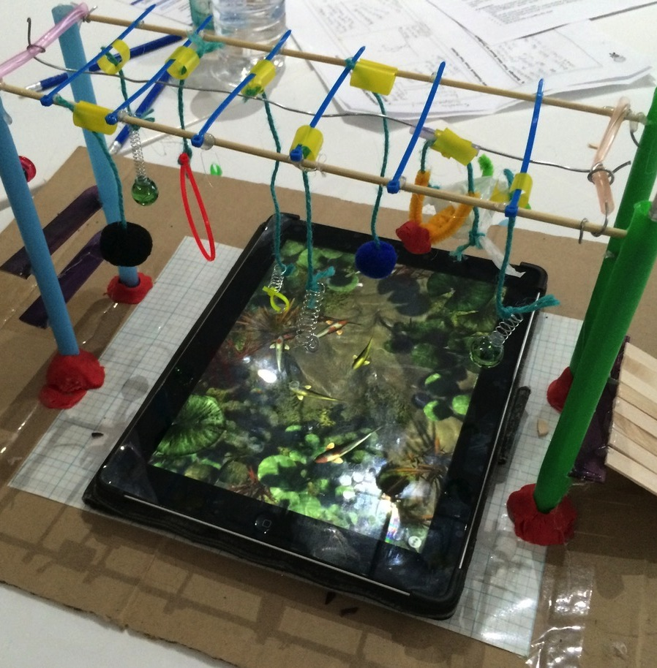
Reflecting on the day
Thanks to:
Desiree
Karine
Scott
Rachel
Sheri
From the Field

Slide 34
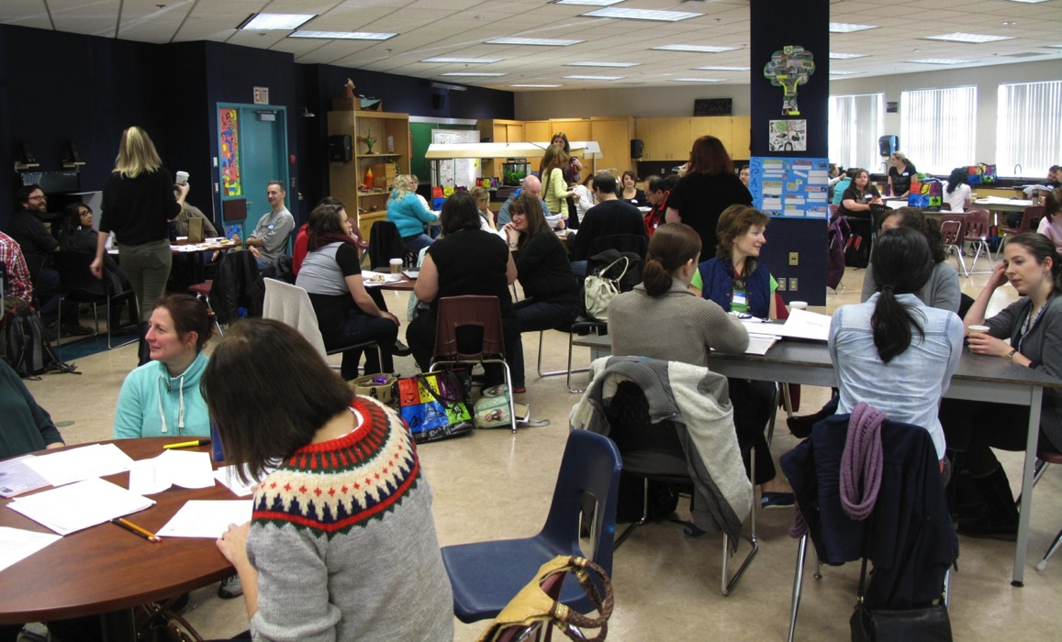
observations
Thanks to:
Broyden
Elaine
Jennifer
Chris
Larry
From the Field

Slide 35
share your event
Use this PowerPoint Template to share your Maker Day pictures, videos and tips

Slide 36
When planning your event…
Use any of the slides, pictures and/or videos provided in this PowerPoint for your event
Edit/Adapt any slides with your own pictures and/or videos either before or after your event
Have a team member take pictures and videos of your event to share with those who were not able to participate
Provide us any public links so we might share with others (email: youth@itabc.ca)

Slide 37
feedback and suggestions
Help us to provide what others might need

Slide 38
Remember to ‘update often’
We welcome all feedback and suggestions for improvement! Email us: youth@itabc.ca
Let us know how your event went and what resources others might require
Please ‘tweet out’: @ilcubco @ita_youth
Visit our websites regularly:
http://www.itabc.ca/youth
http://www.innovativelearningcentre.ca

Slide 39
Glossary
The following slides provide Key Terms used in Maker Day: Taking Making into the Schools
This Action Button beside the term takes you to the slide
where the term was used.
This Action Button brings you to the Glossary Key Term.
Reminder: Action Buttons only work when ‘Playing the Slide Show’

Slide 40
constructionism
In Papert and Hare’s (1991) theory of constructionism, the best way to construct
knowledge and understanding is through the construction of something shareable —
outside of the student’s head. In a Maker Day, the design challenge is crafted using
students’ previous learning (i.e., ties to curriculum), the design thinking process is
where students apply their previous learning to design their prototypes (i.e., the
artifacts of the students’ applied learning and/or new learning). During the gallery
tour/design charrette, the students see and hear the evidence of their learning.
Additional Resources:
Papert, S., & Harel, I. (1991). Constructionism. New York, NY: Ablex Publishing Corporation.
Martinez, S. & Stager, G. (2013). Invent to learn: Making, tinkering, and engineering in the classroom.
Torrance, CA: Constructing Modern Knowledge Press.

Slide 41
Design challenge
Your design challenge meaningfully links the Maker Day activities to your purpose
(i.e., professional development, curricular ties).
The structure of a Maker Day Design Challenge includes:
Overview – Paragraph or two to situate (i.e., offer background / context) the challenge and provide an authentic learning context or situation
Design Rationale - Paragraph or two explaining why the challenge is in fact a problem to be addressed, links to prior learning and offers links to new information
Problem Scenario – Paragraph inviting participants into the challenge and explaining the role / reason for their group’s involvement in addressing the problem
Success Determinants– Criteria assessment using suggested characteristics / attributes that constitute a good design solution for the challenge
Parameters – Specific issues, constraints or limiting factions impacting the participants and should address (i.e., rules, limitations)

Slide 42
Design thinking
The video, ‘Design is Optimism’ is a presentation on Design Thinking … including the Five Traits of
a Design mindset (Empathy, Integrative Thinking, Optimism, Experimentialism, Collaboration). Enjoy!
There are possibly as many different design thinking processes as there are designers multiplied by design problems. Design-thinking processes have become part of many contemporary professional practices addressing social issues (i.e., business, management, engineering, urban planning). These broader uses of design thinking describe a particular style of “creative thinking-in-action” through three common iterative group processes: problem finding, brainstorming and prototyping.
Integrating imagination, creativity and reflection, Maker Day uses a Human-Centered Design Thinking Process adapted from Stanford d.school. Human-Centered Design Thinking is a process that enables participants to engage in integrative thinking and begin to gain empathy for other people’s points of view. The Facilitator Guide (Section 3.4., p. 33) has been recently updated and is available as a Word document on the ILC’s Maker Day Toolkit page http://innovativelearningcentre.ca/maker-day-tool-kit/

Slide 43
Integrating
By taking Making into the schools, we are developing and designing learning experiences to turn theory into practice, ideas into designs, and designs into prototypes. Aligning nicely with the Maker Day Concept are integrated curricular frameworks like Applied Design, Skills and Technology (ADST) and Science, Technology Engineering, Mathematics — User Experience (STEM_{x}). Maker Days include ways to encourage ALL students to explore content, skill sets and competencies in trades training.
More generally, the Organisation for Economic Co-operation and Development (OECD) describes these learning experiences which integrate content, skills sets and competencies as:
Learner-centered: highly focused on learning but not as an alternative to the key role for teachers
Structured and well-designed: requires careful design and high professionalism alongside inquiry & autonomous learning
Profoundly personalized: acutely sensitive to individual and group differences and offering tailored feedback
Inclusive: such sensitivity to individual and group differences means they are fundamentally inclusive
Social: learning is effective in group settings, when learners collaborate, and when there is a connection to community (OECD, 2011).

Slide 44
making
In terms of the Maker Movement and maker mindset, making describes the act of
constructing, fabricating and designing things — physically, conceptually and
digitally. Within the context of Maker Day, Making is a pedagogical orientation and
intentional mindset that embeds integrated frameworks (i.e., STEM_{x} and/or ADST)
involving content, skill sets and competencies within and across a curriculum to
develop and design authentic, constructionist learning opportunities.
Additional Resources:
Crichton, S. E., & Carter, D. (2015). Taking Making Into the Schools: An Immersive Professional
Development Approach. In M. Niess, & H. Gillow-Wiles (Eds.) Handbook of Research on Teacher
Education in the Digital Age (pp.412-438). Hershey, PA: Information Science Reference.
doi:10.4018/978-1-4666-8403-4.ch016
Dougherty, D. (2013). The maker mindset. In M. Honey & D. Kanter (Eds.), Design, make, play: Growing the next generation of STEM innovators (pp. 7-11). New York, NY: Routledge.
Dougherty, D. (2012). The maker movement. Innovations, 7(3), 11-14.

Slide 45
Creative commons licensing
Maker Day Slide Layout and Notes, Planning Your Maker Day-PPT2010, Planning Your Maker Day-PPT2011, and Guide to Planning Your Day PowerPoints (Toolkit Version 2) by
Dr. Susan Crichton and Deb Carter, PhD ( c ) is licensed under a Creative Commons Attribution-NonCommercial-ShareAlike 4.0 International License.
Notes:
Creative Commons Licensing

Slide 46
TEST SLIDE
Body: Trebuchet MS
Headings: Arial Rounded Mt
4:3
72 quotes & text
48 URLs & citations
24 credits

