Slide 1
MALAT PROGRAM OVERVIEW
The Link
June 2020
Elizabeth Childs, PhD
Program Head MALAT
Royal Roads University

Slide 2
Notes:
Acknowledgement of Traditional Lands
Please use this slide as the second slide in your presentation to acknowledge the lands.
Xwsepsum (pronounced Kosapsum)
Lkwungen (pronounced Le-KWUNG-en)
Scia’new (pronounced Chee-a-new)
T’Sou-ke (pronounced Tsa-awk)
Hay’sxw’qa si’em (pronounced Hy-sh-kwa sea-em)

Slide 3
Session Overview
Welcome and Introductions
MALAT/DipLAT Program Overview
RRU Learning Model
Program Goal and Learning Outcomes
Cross Cutting Themes
Assessment
Rights & Responsibilities
Cohort Representative discussion
Next Steps – The Link
Questions

Slide 4
Our vision as a school is to inspire leaders in learning and innovation

Slide 6
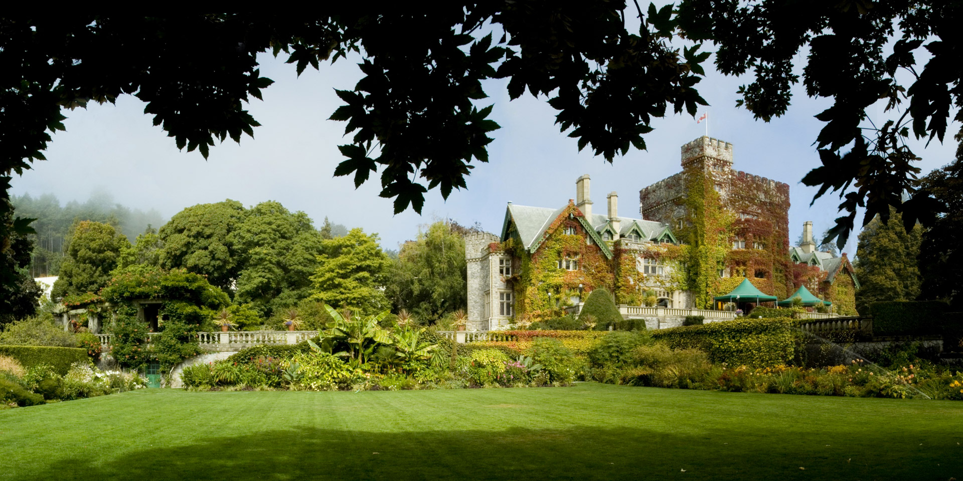
A Strategic Focus on Learning & Teaching
MANDATE
Applied
MISSION
VISION
Connecting people, ideas, & experience for change
Professional
Responsive
Teaching & research for transformation
VALUES
Enabling
Relevant
Collaborative
Committed
Inspiring
Sustainable
Diverse
Inclusive

Slide 7
Overview of You!
Turn on your camera or type in the chat and introduce yourself ☺
Where are you joining us from?
What is your current role?
What sector do you work in?
What do you hope to achieve in this program?

Slide 8
Why Learning & Technology?
Organizations and communities dealing with rapid change and increased complexity
Life long learning is critical
Technologies are increasingly common and used in learning
Networked learning and open practices are central to contemporary learning experiences.
Increasing demand for people who understand how learning and technology relate and can support and extend learning
Notes:
Where would you like to go? Graduates of MALAT work in a variety of sectors in the creation and evaluation of digital learning environments. In their work they apply theoretical and practical knowledge to critically analyze learning innovations and assess their impact on their organizations and society. They design, collaborate, create, deliver and support contextually relevant, human centred learning experiences that incorporated the best of what we know about learning and the affordances of the technological tools of the time. They use research and evidence to inform what they do and continually reflect, refine and improve their work. They take a leadership role in their organization and in the digital learning networks and communities in the field. It is a portable, dynamic skill set that allow our graduates to work cross sectorally in roles such as Education Managers in fields such as telecommunication, finance, health care, education, aviation and other industries. Several of our graduates also work for teaching and learning centres in colleges and universities working with faculty to assist them in integrating new paradigms of learning and working with technology into their teaching.
Learning and what we know about the learning process is constantly evolving – we truly are works in progress – what technology can contribute to the learning equation is ccc. The MALAT program responds to need for those who can act as designers, creators, curators, translators and change agents within organizations to help them navigate the changing landscape of the intersection of learning and technology..
Recently, the role of instructional designer was ranked 38th best job in America. The expected job growth over the next ten years is 28 percent and on average, the entry level education is a Master’s degree.

Slide 9
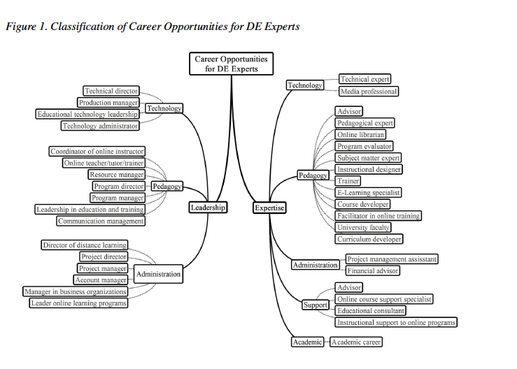
Where can it take me?
April 7, 2020 Dr. Tony Bates Blog Post What should we be doing about online learning when social distancing ends
4. Hire the right staff now
Whatever your institutional strategy or plan for digital learning, you probably do not have enough support staff for digital learning, in particular, instructional designers, app software developers, web designers, and media producers. Digital learning is not going away after Covid-19 but will increase and grow.
Kocdar, S., & Karadag, N. (2015). Identifying and examining degree-granting programs for distance education experts: A preliminary analysis. In G. Kurubacak, & T. Yuzer (Eds.), Identification, Evaluation, and Perceptions of Distance Education Experts (pp. 190-210). Hershey, PA: IGI Global. doi:10.4018/978-1-4666-8119-4.ch012
https://ezproxy.royalroads.ca/login?url=http://dx.doi.org/10.4018/978-1-4666-8119-4.ch012
https://www.tonybates.ca/2020/04/07/what-should-we-be-doing-about-online-learning-when-social-distancing-ends/

Slide 10
The RRU Learning, Teaching & Research Model

Slide 11
LTRM
Applied & Authentic
Interdisciplinary & transdisciplinary
Caring & Community-Based
Inclusive & diverse
Learning community
Transformational
Social innovation, changemaking
Experiential & participatory
Flexible & individualized
0pen practice
Teamwork
Co-creation
Reconciliation
Reflective practice
Sense of place/virtual space
Real world impact
Supportive
Outcomes-based curricula and assessment
Notes:
Our work is APPLIED and AUTHENTIC , characterized by open educational practices, inter- and transdisciplinary, experiential and participatory, and supporting students to individualize their learning.
Learning, teaching, and research are COLLABORATIVE and COMMUNITY-BASED, taking place in communities and virtual space, fostering co-creation, and inclusion in learning communities and teams.
RRU experiences are TRANSFORMATIONAL, creating change and impact in the real world, as well as in individuals.

Slide 12
MALAT/DipLAT Program Goal
The program is founded upon principles of networked learning and open pedagogy where students will collaborate and contribute meaningfully to digital learning networks and communities in the field.
Graduates will be able to work in the creation and evaluation of digital learning environments. Students will apply theoretical and practical knowledge to critically analyze learning innovations and assess their impact on organizations and society.

Slide 13
Program Design Principles
Personalization of learning – choice for students
Openness and the use of open educational resources
Collaboration and contribution to digital learning network(s) and community(ies) using Web 2.0/3.0 tools and strategies
Digital mindset
Networked learning
Inquiry focused
Authentic learning and assessment strategies
Inclusivity
Social justice
Contemporary relevant learning outcomes
Academic rigor
Alignment with School of Education and Technology’s vision
Inclusion of aspects of the RRU Learning and Teaching Model
Alignment with professional certifications (I4PL; IBO; ISPI)

Slide 14
Program Learning Outcomes
Communicate and synthesize information and arguments at graduate level.
Critically evaluate how learning occurs in a variety of contexts.
Design and create research-informed digital learning environments.
Demonstrate effective collaboration skills.
Develop and analyze support strategies to meet the needs of stakeholders in digital learning environments.
Select appropriate assessment and evaluation strategies for digital learning environments.
Contribute meaningfully to digital learning network(s) and communities.
Explain the interrelationship between innovation, change and digital learning environments and their impact on organizations and society.
Apply reflective processes to improve professional practice.
Critically evaluate and/or produce research.

Slide 15
MALAT/DipLAT Program Flow
Residency or Online Pathway The Link – online onboarding and initial community building Introduction to Academic Integrity
Residency or Online Pathway – Foundation Courses (18 credits) Digital Learning Environments, Networks, Communities – kick started by a Virtual Symposium Introduction to Research: Critical Reading and Writing
Both Pathways Merge Foundations of Learning and Technologies Innovation, Design and Learning Environments Leading Change in Digital Learning Inquiry into Contemporary Issues in Learning Technologies (the TAKE course)
Thesis Path (15 credits) | Applied Research Project Path (15 credits) | Digital Learning Research Consulting Project Path (15 credits)
Advanced Research: Thesis Proposal | Creating Digital Resources (the MAKE course)
Thesis (12 Credits) | Facilitating in Digital Learning Environments (the SHARE course)
 | Advanced Research: Applied Research Project or Digital Learning Research Consulting Project
 | Applied Research Project (6 credits) | Digital Learning Research Consulting Project (6 credits)
**Note MALAT 2020 Blended – postponed intake will have LRNT 521 at the completion of their program.

Slide 16
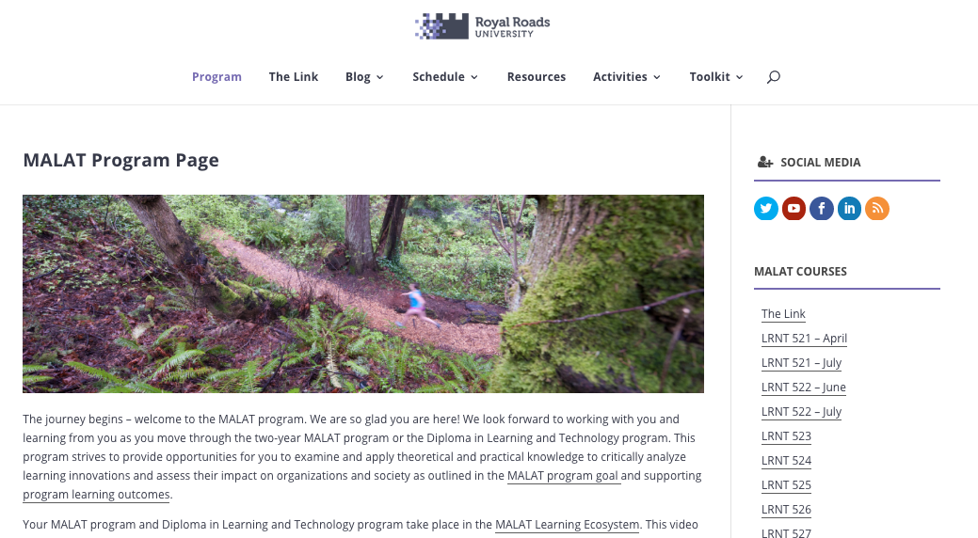
MALAT Program Page https://malat-coursesite.royalroads.ca/malat/

Slide 17
Cross Cutting Themes
Openness
Networked Learning
Digital Mindset
Design

Slide 18
Openness
networked
educators
networked
students
Physical Spaces
Bounded Online Spaces
Open Online Spaces
Image: CC BY-SA 2.0 Catherine Cronin, built on Networked Teacher image CC BY-NC-SA 2.0 Alec Couros

Slide 19
Openness & Networked Learning
Paskevicius, M & Forssman, V. (2017). The role of educational developers in supporting open educational practices. Open Ed Global Mar 8 – 10, 2017 Cape Town South Africa licensed under a Creative Commons Attribution-NonCommercial-ShareAlike 4.0 International License.

Slide 20
Openness as a Design Principle
Goal: openness as a vehicle of educational change
Intention: to extend the mindset of openness across a graduate program – to model a model.
Openness as a design principle provided the lens through which all design decisions (for example: program, course, activities, assignments, readings, delivery, infrastructure, and interactions) were viewed.
Looks like:
OER
Renewable assignments
Open assessments and rubrics
Course, instructor, student public wordpress sites
Contracting agreements (CC BY)
A Zero-Textbook-Cost (ZTC) degree
Notes:
This ensured a consistent approach which allowed for more flexibility in the program design than if openness had been an “add on”. The process of this redesign prompted reflections on the institution’s culture of openness, the necessary levels of support for the MALAT redesign, and the tensions and challenges faced along the way.
Openness as a vehicle for educational change - teaching and learning environments; teaching practices
Consistent with social constructionism; constructivism etc.
The 5 R’s (retain, reuse, revise, remix, redistribute)
Resources; assignments; syllabus
Openness is a goal in itself – to be open for the benefits and challenges we (faculty and students) can experience from being open that go beyond saving students money.
Consistent with the concept of expansive openness (Kimmons, 2016)
Levels of openness; across program/course/activities/assessment

Slide 21
How does it work?

Slide 22
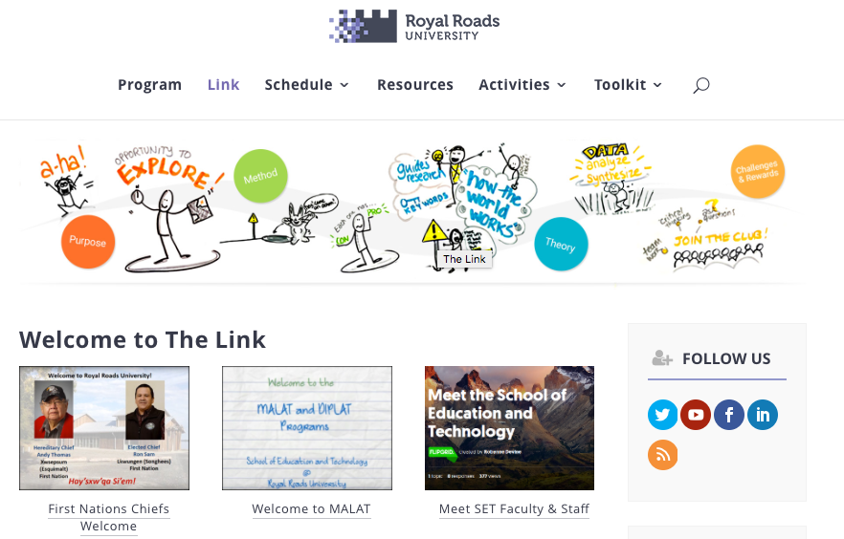
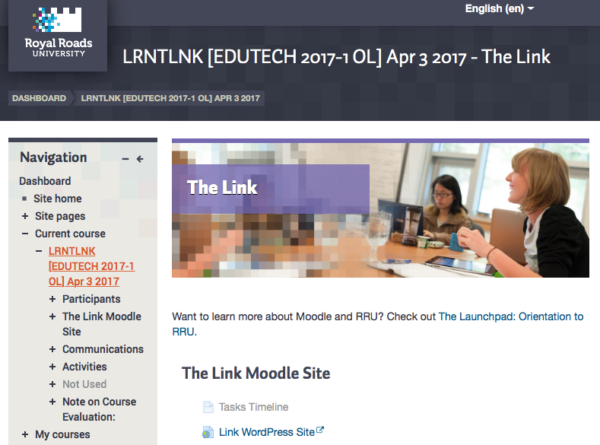
Course Sites (WP) & Moodle
The Link “onboarding”
MALAT Program Page
The Link Companion Moodle Shell
Notes:
There are three + learning spaces in the MALAT program: the course WP site; its companion Moodle shell and your WP blog + all the other social spaces we will present in
The Link attempts to mimick what your course experience will be to some extent by having The Link WP site, its companion Moodle site. You will be given access to your personal WP site the first day of your first course LRNT 521
The MALAT program page is the place where you will be able to find all things program related that we are able to put out on the open ;) It will be continued to be built out over time.

Slide 23
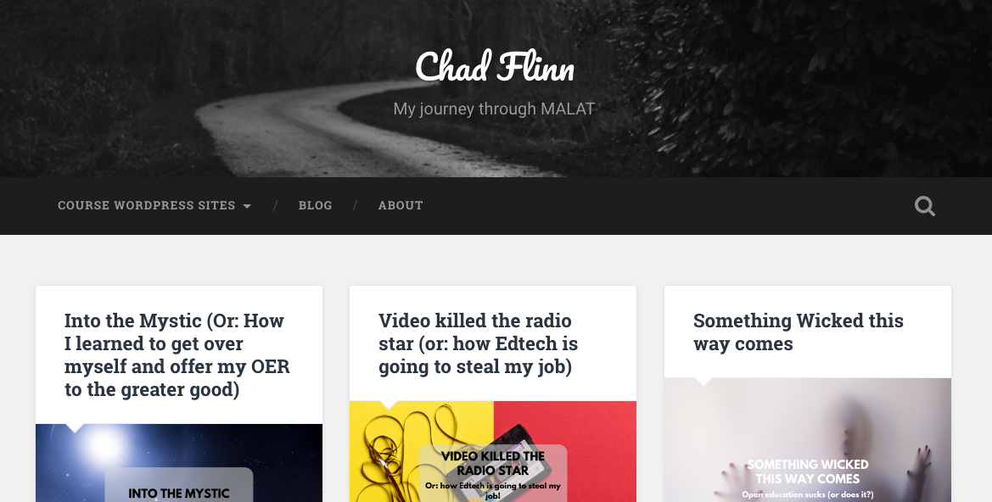
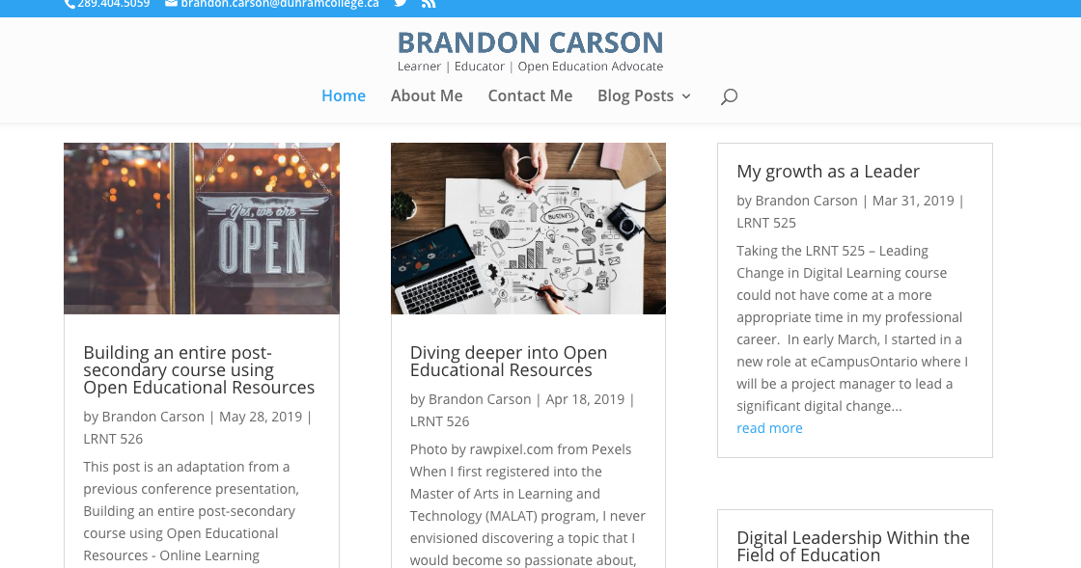
Your WordPress Site
Creative Commons Licensing https://creativecommons.org
Virtual Symposium Presentation on CC Licensing http://ow.ly/cqER30nMZxj

Slide 24
Social Networks
You are asked to consent to the use of social media the first time you log into WordPress & Moodle
Responses are recorded and made available for instructor reference
Response applies to all courses for the duration of your program
You may change your response by editing your profile
#RRUMALAT
@RRUEduStudies
School of Education and Technology RRU
© Dahlquist-Axe Design Ltd
Notes:
Because of BC's Freedom of Information and Protection of Privacy (FIPPA) laws, Royal Roads students need to make a conscious choice to use social media as an appropriate tool in instructor-assigned learning activities.
On July 17, 2014, CTET is launching the Social Media Consent process, where each student will "opt in" or "opt out" of using social media tools to complete course work. This Social Media Consent form will appear when students enter the Moodle environment.
The purpose of this is to offer more support and transparency in the use of social media/third party/external tools in courses at Royal Roads (i.e. tools outside of Moodle - things such as YouTube, blogs, wikis, twitter, Flickr, PopcornMaker, etc).
For information for students and instructors, including screenshots, please see: http://computerservices.royalroads.ca/kb/social-media-consent
For background on why this important check out Social Media Consent.
Questions? Need help? Please contact CTET Studio. Please note that this note has been submitted to Crossroads and will be distributed to students today.

Slide 25
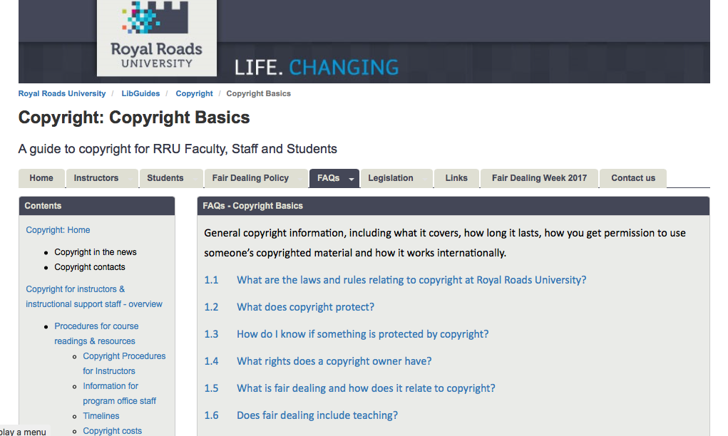
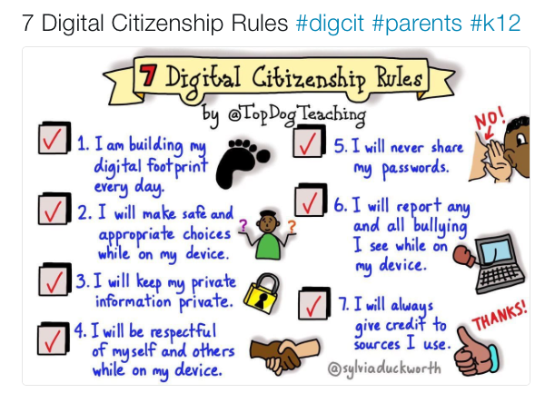
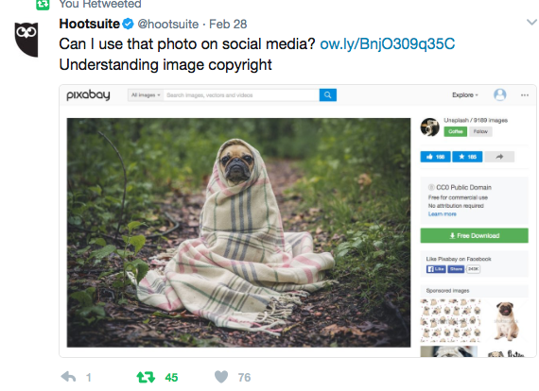
Terms of Use & Netiquette
RRU Terms of Use
Creative Commons Licensing
Netiquette – be your most awesome self!
http://libguides.royalroads.ca/copyright/FAQ_Basics
https://twitter.com/hootsuite/status/836822099696185345
https://twitter.com/uoitmed/status/834993581937000448
Notes:
CC licensing
Netiquette –
Terms of use – Webspaces Terms of Use
Appropriate Use
Users of Royal Roads University (RRU) WebSpace must be aware of, and abide by, the RRU Computer Usage Policy. All users are encouraged to review this policy to ensure that the materials they post are compliant.
Inappropriate Content
Complaints about content posted to an RRU WebSpace should be directed to the RRU Computer Services Help Desk, who will then follow the process outlined in the Computer Usage policy. The University reserves the right to remove materials that do not conform to the Computer Usage policy.
Back-ups
RRU takes measures to back up, secure and safeguard content posted online. However, users are encouraged to also back up their own materials as a best practice.
Ownership and Related Rights
Posting your own work on the RRU WebSpace
Work that you create is protected by copyright automatically under the Canadian Copyright Act, which means that you have the right to determine how it is used. You can retain all of your rights by using the copyright symbol like this:
© 2017 by Jane Doe. All rights reserved.
You can also apply a Creative Commons license to your work, allowing others to reproduce your work in specific ways. You can read all about Creative Commons licenses on their website, or contact the RRU Copyright Officer for more information: copyrightofficer@royalroads.ca
Reproducing other peoples’ work on the RRU WebSpace
Work that is created by someone other than yourself is also protected by copyright – even if it is on the open internet or otherwise publicly available. Before you post it, you must first get permission from the copyright owner (this may be the author, the publisher, or the database vendor). Posting someone else’s work without permission leaves you open to legal action and possible fines. You can avoid this either by linking to the work on the internet instead of reproducing it, or by finding a work that has a Creative Commons license which allows you to use it. Please contact the RRU Copyright Officer for more information: copyrightofficer@royalroads.ca
Publicity
Links to WebSpace websites may be listed in an RRU WebSpace gallery that can be accessed by the public. Users may opt out of being included in the gallery at any time by contacting the Computer Services Help Desk. No personal information about WebSpace users will be distributed via this gallery, only the name and URL of the website will be posted.
RRU WebSpace Online Privacy Statement
The privacy of users of RRU WebSpace is important. RRU supports the protection of privacy and the freedom of information throughout the university in accordance the Freedom of Information and Protection of Privacy Act R.S.B.C. 1996 c. 165.
Personal information provided for a RRU WebSpace website is collected under the authority of the University Act, and is subject to section 26(c) of the Freedom of Information and Protection of Privacy Act, R.S.B.C. 1996, c.165. RRU will not disclose personal user information unless permitted by law or as directed by the user.
The personal information provided will be used to authenticate users to their own WebSpace website. Each user will have full administrative rights to their own WebSpace website.
RRU WebSpace websites and the supporting pages contain links to external websites. RRU does not control or monitor these external links and will not be held responsible for their content or links therein. External websites are not covered under the RRU WebSpace Online Privacy Statement.
RRU reserves the right to amend this online privacy statement at any time without notice.
For more information, please contact:
Privacy Officer
Royal Roads University
2005 Sooke Road
Victoria, B.C. V9B 5Y2
Phone: 250.391.2600 ext. 4178
Access to WebSpace
Users must have an active RRU account to have administrative privileges for their WebSpace website.
For students, this means that their WebSpace will be deleted when their RRU academic account is deactivated, per RRU guidelines.
Students are responsible for migrating their WebSpace content to another hosting environment prior to their RRU academic account being deactivated. Instructions for migrating content from a WebSpace website to another, non-RRU hosting environment are provided here.
User Agreement
By using the RRU WebSpace service, users agree to these Terms of Use. Although RRU makes every effort to maintain the security of this service and your personal information, RRU cannot guarantee against, and is not responsible for, unauthorized access or fraudulent use of personal information.
Contact Us
Contact us via the RRU Computer Services website.

Slide 26
Assessment types

Slide 27
MALAT/DipLAT Assessment Types
Contribution Rubric
Team Assignments (up to 25% of total course mark)
Individual Assignments
Self-Assessment
Peer Assessment
Ongoing blog posts
Notes:
Contribution Rubric
In every course – may or may not be formally assessed but expected to actively contribute to the collective learning of the class and share beyond with your growing network via your blog
Assessment of Your Contribution to the Learning Community
While your instructor will discuss key ideas and raise important issues that you need to understand, the majority of this course will be guided by dialogue, discussion and inquiry. Think about this course as a guided conversation that begins on the first day we meet and ends on the last scheduled day of class. In order for this learning experience to be beneficial and worthwhile to everyone, it is imperative that you read the assigned material, contribute to the discussions, and participate in all class activities. Conversations and ideas cannot grow if you don’t read the assigned material, reflect on their relevance and meaning, and/or contribute to the class discussions. Participation should be thoughtful, meaningful, timely, and relevant.
In responding to your colleagues, you should feel free to suggest that they explore appropriate websites or resources to expand the discussion to a deeper level. However, please do ensure to provide explanations on why such resources are of relevance and interest to the rest of the class and provide an accurate reference to the resource.
Also, please consider how your contribution will advance and extend the discussion. For example, in your response, you can draw from the assigned readings, pose questions, reflect back to your own experiences, connect to a course reading/assignment, ask for clarification, build connections between your thoughts and other students’ perspectives, and/or offer alternative perspectives

Slide 28
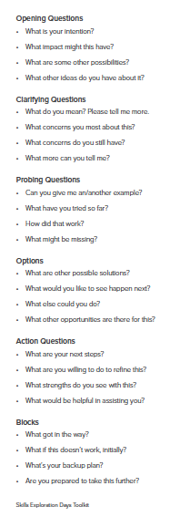
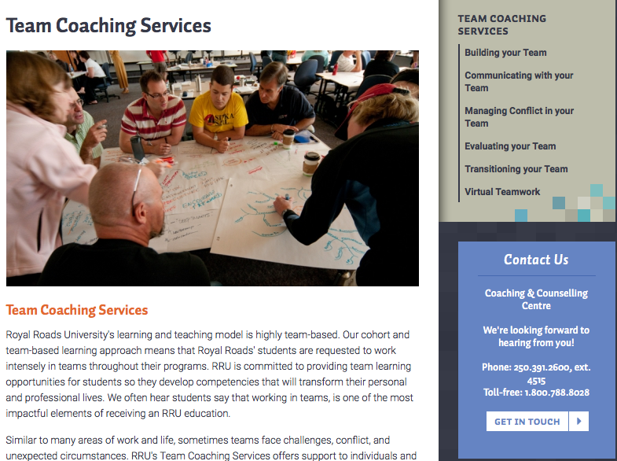
Feedback & Peer Assessment
Asking Good Questions
Being a Critical Friend
Team Coach
http://www.mytrainingbc.ca/maker/downloads/Taking_Making_into_Classrooms.pdf

Slide 29
RRU Graduate Grading Scale
Letter Grade | Grade Point | SET Specific Description
A+ | 4.33 | Learner consistently exceeds all assessment criteria specified for the competency and learning outcomes
A | 4.0 | Learner consistently meets all assessment criteria with 2 or 3 major instances of exceeding assessment criteria specified for the competency and learning outcomes
A- | 3.67 | Learner consistently meets all assessment criteria with 2 or 3 minor instances of exceeding assessment criteria specified for the competency and learning outcomes
B+ | 3.33 | Learner consistently meets all assessment criteria specified for the competency and learning outcomes
B | 3.0 | Learner consistently meets all assessment criteria specified for the competency and learning outcomes with 2 or 3 minor instances of not doing so
B- | 2.67 | Learner meets all assessment criteria specified for the competency and learning outcomes with more than 3 minor instances of not doing so

Slide 30
RRU Graduate Grading Scale
Letter Grade | Grade Point | SET Specific Description
F | 0.0 | Learner meets some but not all assessment criteria specified for the competency and learning outcomes with 2 or 3 major instances of not doing so; OR Learner has not provided sufficient and/or sufficiently timely evidence to enable a determination as to whether all assessment criteria specified for the competency and learning outcomes have been met

Slide 31
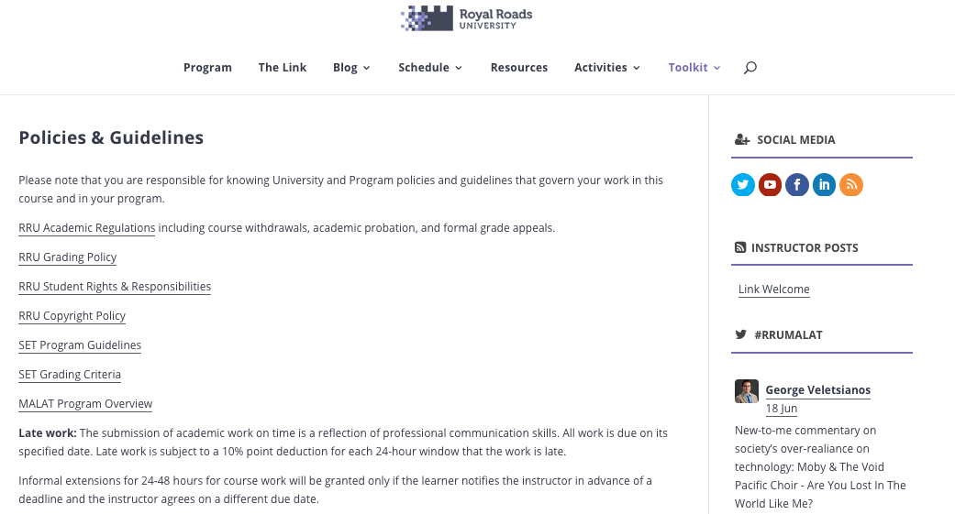
Student Rights and Responsibilities
It is your responsibility to be familiar with academic regulations:
https://student.myrru.royalroads.ca/academic-regulations
http://research.royalroads.ca/sites/research.royalroads.ca/files/RRU_AcademicIntegrity_PolicyandProcedures_rev_15sep10.pdf
https://malat-coursesite.royalroads.ca/malat/readings-and-resources/policies-guidelines/
Notes:
https://student.myrru.royalroads.ca/academic-regulations

Slide 32
Next Steps

Slide 33
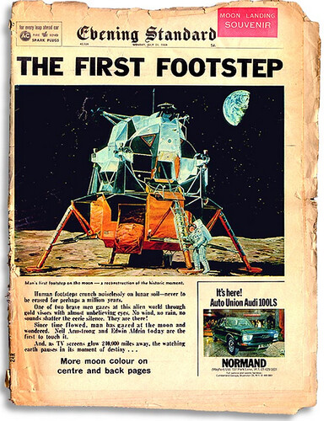
"Ebening Standard (Foto: BBC)" by clasesdeperiodismo is licensed under CC BY-NC-SA 2.0

Slide 34
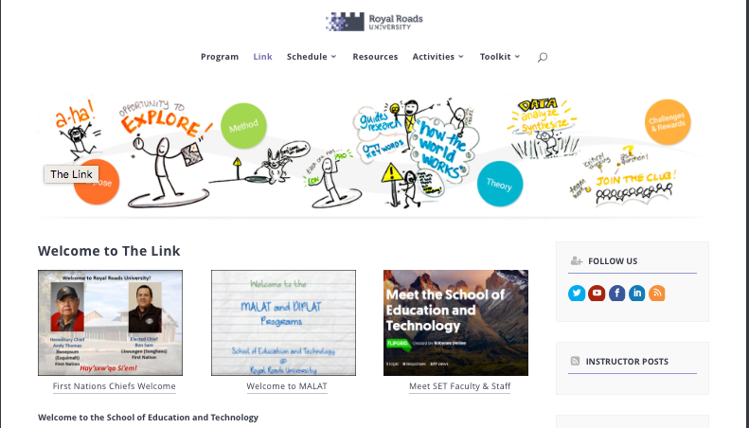
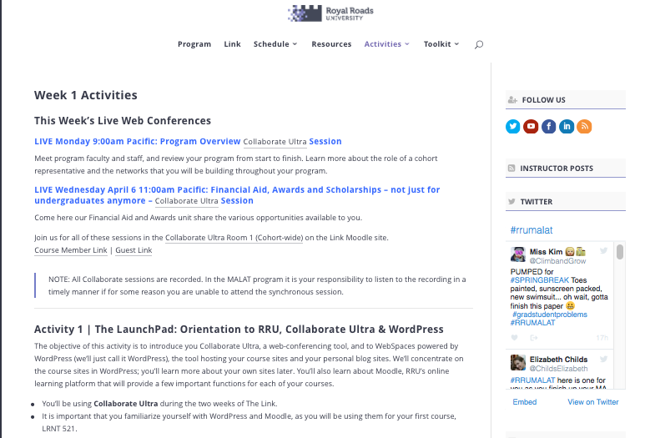
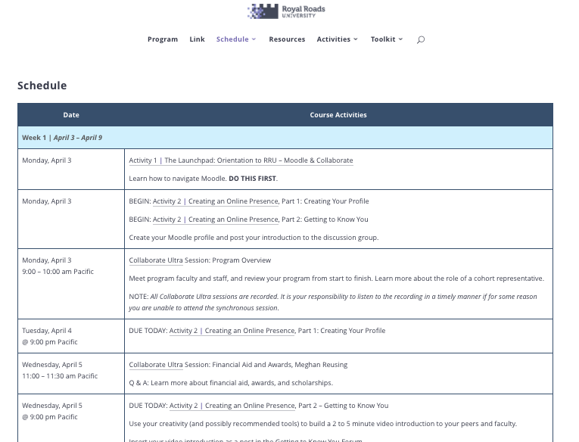
“Onboarding” – The Link
Notes:
Schedule – itemizes activities to do each day and let’s you know when to block synch sessions in your calendar
Activities – detailed descriptions of the activities to complete/week
The Link must be completed prior to being able to start your first course
IA must be completed

Slide 35
Ways to Connect with Each Other
Make an effort to stay connected: to your fellow MALAT/DipLAT learners; to your program; to your growing network ;)
How?
The Link Activities – that’s what they are designed for
#RRUMALAT twitter hashtag - follow & contribute to this and others that emerge
Your WP site – blog and Feedly
Your networks – connect and interconnect others
Don’t hesitate to email
Attend Skype open “office hours” in your courses
Virtual team resources – see TeamsWorks teamswork.royalroads.ca

Slide 36
Cohort Representative
There are two MALAT/DipLAT cohort reps – one for the fully online program and one for the blended program.
You may put your name forward or you may nominate someone else.
Take time to review the role of the cohort representative as well as the short video created by a previous MALAT cohort representative in The Link.
Based on nominations, the cohort representative will be voted on/acclaimed during LRNT 522.

Slide 37
IBO – Advanced Certificate in Teaching and Learning Research
MALAT students who meet the criteria for the IB Advanced Certificate in Teaching and Learning Research can complete this in parallel with their MALAT degree.
If meet criteria, notify the MALAT Program Office of intent.
Focus assignments & literature used on the IBO context.

Slide 38
Tamara Leary
Director SET
Tamara.leary@royalroads.ca
Elizabeth Childs
Program Head MALAT
Elizabeth.Childs@royalroads.ca
Marlene RYAN
Program Associate
Marlene.ryan@royalroads.ca

Slide 39
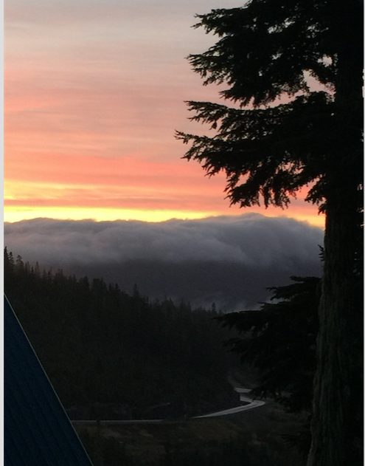
Image: CC BY 4.0 Elizabeth Childs
Keep the big picture in mind
Hold on to your sense of humour

Slide 40
Questions & Thanks

