Slide 1
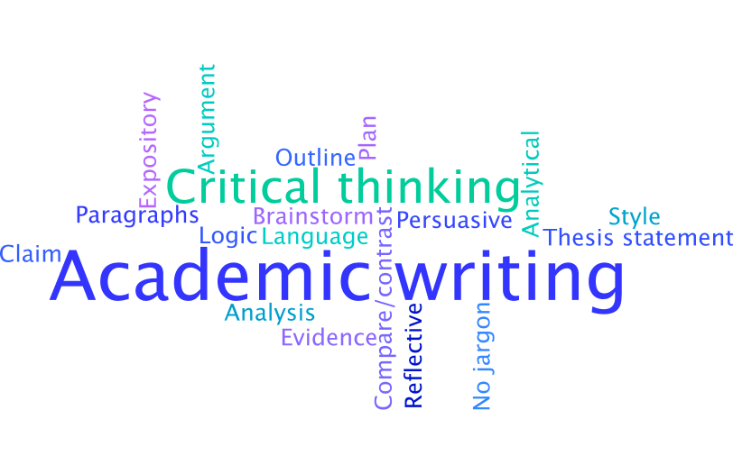
Introduction to Academic Writing
Theresa Bell
Royal Roads University
© Royal Roads University
Notes:
Hello, and welcome to this introduction to academic writing. My name is Theresa Bell. My goal for this video is to give you an overview of some of the skills you’ll be building as you learn more about academic writing. Specifically, the qualities that will be expected in your academic writing, the types of essays you may be asked to write, how to demonstrate your critical thinking within your work, and finally, how you can plan an essay.
If you’re a Royal Roads student and you have questions regarding the content in this video, please contact the Writing Centre so that we can assist you.
Let’s get started!

Slide 2
What’s the story you want to tell?
Your voice
Other sources of knowledge
Four Feathers Writing Guide
Four Feathers Writing Guide
Notes:
If you’re feeling anxious about your academic writing, that’s a totally normal emotion. Students often feel nervous about academic writing for a number of reasons, such as it’s been a long time since they were at school, or perhaps they’ve never been to university, or they may be feeling intimidated by the pressure to write in a style that feels very different to their own voice, such as what students experience in course readings. The style in those readings can be dense and difficult to understand with a lot of unfamiliar terminology. Also, there may be complex explanations that seem to be aimed more at showing off how much the author knows than trying to communicate with the reader. It’s likely that those readings were chosen for the content they provide, rather than them being good models of academic writing.
If you come to meet with us in the Writing Centre to talk about those anxious feelings, we’ll encourage you to focus on the story you want to tell in your writing. Writing an essay might feel intimidating, but sharing stories is something we all do everyday, whether that’s in writing, verbally, music, works of art, and so forth. Story is familiar, and you know better than anyone else how your ideas, experiences, critical thinking, and other sources of knowledge connect to create the story of your understanding. You know best how you connect all those elements, which means you can be the expert in the story, just by starting with the question of “what’s the story I want to tell in this work?”

Slide 3
Qualities of academic writing
At RRU, academic writing:
Shares the story of your understanding of the topic
Often an in-depth analysis with an evidence-based approach
North American academic English prioritizes language that is clear, concise, and easy to understand
Avoids assumptions of reader knowledge or experience
Demonstrates the outcomes of the assignment
Consistently and correctly follows the APA Style rules; see APA Style (7th ed.) for more information
Concise Writing & Academic Writing
Notes:
On this slide, you can see some qualities that your instructors will likely look for in your academic writing.
To start with, you will be asked to tell the story of your understanding of the topic, which typically involves an in-depth analysis that uses an evidence-based approach. I’ll get into more information about what that means in a few minutes, but I think this piece is the defining quality of what makes academic writing different from other types of writing: you’re being asked to present your understanding of a topic and to provide evidence that supports your analysis. For example, in business writing, you might identify a problem and how to solve it. The emphasis may not be on what you personally think, but rather how you’re presenting your organization’s message to your audience. Your credibility on the topic comes from the role you have in the organization – in other words, your audience can look at your job title and know it’s your part of your job to be an expert on the topic. In academic writing, the focus is on your thinking as an individual, and since you don’t know if your audience thinks about the topic in the same way as you do, you need to demonstrate how you know what you know. For example, you could identify the problem, how to solve it, and show why or how you know that solution is the best option. “Why?” is a critical question in academic writing, and usually, the answer to the question is provided through a demonstration of the author’s critical thinking skills.
If the “what” of academic writing is the story of the author’s understanding of a topic, the “how”, or the academic style, will likely follow standards of North American academic English, which typically means clear, concise, and easy to understand language. If you think about the kind of writing you like to read, it’s likely that aside from interest in the topic, one of the appealing features of the writing is that it is easy to understand. Overly-complicated and unclear writing doesn’t help readers, so when you’re writing, create the text you would like to read. Let’s look at each of these elements.
First, clear language is simple and direct. Avoid jargon or vocabulary that your reader isn’t likely to understand – all those words do is show that you can use complicated words, versus the words actually aiding your reader’s understanding. New students often get distracted by what I call “shiny words” – the words look great in the text and they sound fantastic, but they don’t live up to expectations in aiding your reader’s understanding. If all your word choice does is send your reader to a dictionary, the word wasn’t effective in moving your discussion forward. Here’s an example – students love the word “utilize”, but “use” is a perfectly good word that most people would understand. When it comes to choosing your words, think about your audience member as someone in the general academic community who is capable of understanding your writing but who may not have your knowledge, background, or experience on the topic. What language would that person most likely understand?
Moving now to being concise, North American academic audiences typically prefer concise writing to help readers identify the key messages in a text. If you only have 500 words to express your ideas, every one of those 500 words needs to contribute to your discussion. Writing concisely allows you to focus your word count on the key messages without your reader being distracted by extra information. A good general guideline is to keep sentences to 20-25 words or fewer. Longer sentences are harder for readers to understand because they present many different ideas. Also, if the reader can’t remember the starting point of the sentence by the time the sentence is finished, the sentence isn’t going to make sense. For more information, please visit Concise Writing.
My last tip regarding the North American academic style is to make your text easy to understand, which will help your reader understand your thinking on your topic. What I mean by “easy to understand” is that all the information the reader needs to make sense of the discussion, including all the necessary explanations and connections between ideas, is provided within the text. That approach means readers can easily follow the discussion, rather than leaving it up to the reader to provide explanations. Avoid making assumptions about what your reader might already know or understand; instead, if the information is necessary for your reader to understand your thinking on the topic, include it in your text. This approach might seem strange when you’re writing for an instructor who you know is familiar with your topic; however, while it’s true that your instructor knows the material, your instructor wants to understand what you think about the topic and how your thoughts fit together. The only way to demonstrate your thinking is to make it obvious in the text. The challenge of academic writing is to take complicated ideas and express them simply so that your reader can easily access and understand your thinking.
Moving now to the next bullet on this slide, you might think that “demonstrates the outcomes of the assignment” would be an obvious point; however, it’s easy to lose track of what an assignment is supposed to do when you’re distracted by learning something new. For example, if you follow every burst of inspiration that strikes you as you’re writing, your essay will likely be a collection of what I call “popcorn thoughts” – that is, lots of different ideas that pop all over the place but that don’t have an obvious connection between them. Remember that what is obvious to you might not be obvious to someone else. Unfortunately, our brains don’t provide inspiration in the moment that it would best serve an essay; rather, inspiration tends to strike randomly, and it’s then up to you to decide how you’re going to harness it. If you don’t check in with your assignment description or document plan to make sure that the new idea fits into what you’re doing, you can easily find yourself writing an essay that has little to do with the assignment’s outcomes. In that scenario, regardless of how brilliant the inspiration was, the instructor can only mark the assignment against the outcomes, which means the mark will probably suffer because the essay didn’t stay on topic. One way to make sure you stay on track while you’re writing is to post the outcomes for the assignment somewhere that you can easily refer to them to make sure you’re still on topic. It’s so much easier to catch yourself while you’re in the process of writing and bring yourself back to the topic than to revise large sections of an essay. By posting the outcomes, you can quickly and easily confirm that you’re still on topic, and if you’re not, you can bring yourself back to the required focus.
The last point on this slide notes that students at RRU primarily use the APA Style rules. I’m not going to address APA Style in this video, but the Writing Centre has extensive APA Style resources. I’ve provided the link to our resources, and if you can’t find the information you need, please contact the Writing Centre so that we can assist you.
To wrap up this slide, the goal of academic writing is to tell the story of your thinking to your reader, and the qualities of academic writing that your instructors will likely be looking for are those that will make it easy for a North American academic reader to understand your text. For more information, please click on Academic Writing.

Slide 4
Personal or reflective writing
Focus is on your thoughts and experiences
Present your thoughts on a reading, discuss a personal experience, apply a theory to a real-life example, or some other focus that asks you to think about and explain your thoughts and experiences
Use the first person voice (I, me, my)
Can I use the first person voice in my academic writing?
Usually less formal than a standard research paper
Academic Writing & Reflective Writing
Notes:
I’m going to use the next four slides to briefly describe a few types of essays you may be asked to write during your program. These aren’t a comprehensive list, so please click on Academic Writing for more information.
This slide provides information about writing personal or reflective essays. The typical focus of reflective writing is to connect your thoughts or experiences to course readings or concepts, so it’s appropriate to use the first-person voice, which means using “I”, “me”, “my”, and so forth. In fact, the first person voice is usually preferred in all types of academic writing, rather than using a third-person, objective voice to refer to yourself, which means using “I” instead of “the author” when you’re talking about yourself. The APA Style rules also encourage authors to use the first person voice; for more information, please click on Can I use the first person voice in my academic writing? Finally, reflective writing is often less formal than a standard research paper, though please make sure that you still cite and format everything correctly.
For more information, please click on Reflective Writing.

Slide 5
Expository writing
Informs or introduces your reader to a subject
Doesn't argue a position but rather explains the issue
E.g., an expository essay might present an overview of the differing views on a specific topic, whereas an argumentative or persuasive essay will choose which approach is the most appropriate.
An expository essay explains things to your reader
Notes:
The next type of assignment is an expository essay. The purpose of this type of writing is to present information to your reader. You don’t need to take a position or defend an argument; rather, you’re explaining what your reader needs to know to share your understanding of the topic. I remember the purpose of an expository paper by thinking that expository writing explains.

Slide 6
Argumentative or persuasive papers
Using sound reasoning, support a claim with research evidence
Fact: Emotional intelligence is “perceptiveness and skill in dealing with emotions and interpersonal relationships” (“Emotional intelligence, n.d., para. 2).
Claim: Emotional intelligence is a key factor to consider when assessing someone’s leadership potential.
Synonyms: appeal, assert, claim, contend, defend, demonstrate, display, establish, explain, justify, persuade, present, reason, show
Building an Argument & Academic Writing
Notes:
If you have ever written a cover letter, a letter of recommendation, a request for funding, a project proposal, or any other type of writing that aims to convince the reader to do something or think in a specific way, you’ve written in an argumentative or persuasive style.
Argumentative essays ask the author to make a claim or take a position and then defend that claim, usually with evidence. When you’re writing an argumentative essay, make sure your claim is a statement with which someone could agree or disagree. For example, stating that emotional intelligence is “perceptiveness and skill in dealing with emotions and interpersonal relationships” (“Emotional intelligence”, n.d., para. 2) isn’t a claim, it’s a fact. However, arguing that emotional intelligence is a key factor to consider when assessing someone’s leadership potential makes a claim because someone could agree or disagree with the argument. It would then up to the author of the essay to defend the claim with evidence, and I’ll talk more about using evidence in a few slides.
You’ll see that I’ve provided a list of synonyms on this slide – your assignments might not always explicitly state that you’re being asked to write an argumentative essay; however, if you see any of these words in the assignment description, it’s likely you’re being asked to write in an argumentative or persuasive style. If you’re not sure, please check with your instructor.
For more information on developing persuasive arguments, please click on Building an Argument. To find links to more information on writing argumentative essays, please click on Academic Writing.
Reference
Emotional intelligence. (n.d.). In Oxford English Dictionary. Retrieved from http://www.oed.com/view/Entry/258346?redirectedFrom=emotional+intelligence#eid

Slide 7
Analytical essays
Highlight your critical examination or analysis of a topic in order to interpret the strengths and weaknesses of a debate.
Often uses a compare-and-contrast model
E.g., if asked to analyse two models, you would look at each author’s claims, the evidence used to support the model, consider the assumptions, and then demonstrate how the models are similar and different.
Synonyms: explain, consider, determine, dissect, divide, estimate, evaluate, figure, interpret, investigate, resolve, scrutinize
Academic Writing
Notes:
Analytical writing requires the author to assess a problem or issue and provide an objective critique. Authors often use a compare-and-contrast model in order to present the strengths and weaknesses of a debate. For example, to analyse two models, an author would examine each author’s claims, the evidence they used to support their models, consider the authors’ assumptions, and then demonstrate how the models are similar and different.
The difference between an analytical and an argumentative essay is that the analytical essay identifies how things are similar or different, usually without taking a stance on the issue or problem, whereas an argumentative essay requires the author to defend a position. As you progress to writing more complex essays in your program, you may find you’re asked to write essays that use a combination of argumentative and analytical strategies. That is, you might be asked to analyze a debate, and then make and defend a claim regarding which side you think was most convincing.
As in the last slide, I’ve provided a list of synonyms on this slide, and again, if you see these words in your assignment description, you’re probably being asked to write analytically. If you’re not sure, please check with your instructor.
To find links to more information on writing argumentative essays, please click on Academic Writing.

Slide 8
What is critical thinking?
In a Western approach, “critical thinking is the analytical thinking which underlies all rational discourse and enquiry. It is characterized by a meticulous and rigorous approach” (Black, 2012, p. 52).
Critical thinking is a process that includes:
“Analysing arguments
Judging the relevance and significance of information
Evaluating claims, inferences, arguments and explanations
Constructing clear and coherent arguments
Forming well-reasoned judgements and decisions” (Black, 2012, p. 52).
Cultural Variance, Critical Thinking, and Indigenous Knowledges: Exploring a Both-Ways Approach (Chirgwin & Huijser, 2015)
Notes:
In the Writing Centre, we recognize and welcome that there are many ways to approach critical thinking. We also acknowledge that North American academic writing can be exclusionary and colonial, and we are working toward decolonizing our ways of thinking, knowing, and sharing information. For the purposes of this video, we’re going to focus on a Western approach to critical thinking to address some typical expectations of North American academic writing. If you’re interested in learning more about critical thinking in other ways of knowing and being, please refer to Cultural Variance, Critical Thinking, and Indigenous Knowledges: Exploring a Both-Ways Approach, which is linked in the slide.
On this slide, you’ll see a definition and some of the processes that are involved in thinking critically. If you’re feeling overwhelmed by reading those descriptions, remember that you’ve used your critical thinking skills any time you’ve examined a problem, issue, or situation where you have looked at all aspects of the problem to reach a reasoned decision. You’re not new to critical thinking; for example, you would have used your critical thinking skills when you made the decision to come to Royal Roads because you had to answer questions like “why Royal Roads?” and “why this program?”. The process and action that might be new to you is demonstrating your critical thinking in writing.
References
Black, B. (Ed.). (2012). Critical thinking. An A to Z of critical thinking. Bloomsbury Publishing.
Chirgwin, S. K. & Huijser, H. (2015). Cultural variance, critical thinking, and Indigenous Knowledges: Exploring a both-ways approach. The Palgrave Handbook of Critical Thinking in Higher Education. Advance online publication. https://doi.org/10.1057/9781137378057.0027

Slide 9
Demonstrating critical thinking
E.g., Victoria’s climate enables residents to enjoy outdoor activities, which contributes to a higher quality of life
Your idea
Claim
Fact(s) from other sources of knowledge that support your claim
E.g., “Victoria has an average of 308 clear days per year and receives 66.5 cm of rain” (Tourism Victoria, n.d. para. 1)
Evidence
Analysis of connection between evidence and claim
Answer the “so what?” or “why should I care?” for your reader
E.g., Victoria’s mild climate allows residents to enjoy outdoor activities year-round, which means people live more active and healthy lives.
Building an Argument
Notes:
This slide shows an Oreo cookie model of demonstrating critical thinking. If you’re familiar with Oreo cookies, you’ll know that they are sandwich cookies with 2 outer chocolate cookies and a middle layer of white icing. We use this model to help students think about what they’re doing in the body paragraphs of essays; introductory and concluding paragraphs have a different function and structure, but in North American academic writing, this structure is typical for body paragraphs.
As I’ve already discussed, the cookie starts with your idea, not someone else’s. By starting your paragraph with your argument or claim, you signal to your reader what you’re focusing on in the paragraph, and again, this helps your reader to understand your thinking process. Usually, the argument or claim is provided in the topic sentence of a paragraph.
Next, there’s the layer of evidence, where you’ll provide information from other sources of knowledge that support your claim. The evidence doesn’t make the claim for you; rather, it supports your claim. For example, if my overall goal for the essay is to demonstrate that Victoria is a great place to live, I would break that argument down into sub-claims and provide evidence that supports them because providing the evidence alone wouldn’t give the reader enough information to understand my thinking. I’ll show you what I mean - if I started a paragraph with “Victoria has an average of 308 clear days per year and receives 66.5 cm of rain” (Tourism Victoria, n.d. para. 1), my reader wouldn’t understand what I’m doing with that information, such as why do I think that piece of data demonstrates that Victoria is a great place to live? Someone who lives in a desert climate might think that amount of rain sounds dreadful, whereas someone living in a climate that receives much more rain and snow might think Victoria’s climate sounds horribly dry. Since it’s my responsibility as the author to make my thinking clear, rather than expecting my reader to understand how I’m connecting ideas, I need to situate the evidence within the context of my discussion. Instead of starting my paragraph with my evidence, I could instead begin with the claim that Victoria’s climate makes it easy for residents to enjoy many outdoor activities, which contributes to an overall higher quality of life. I could then connect the data on Victoria’s climate to that argument by saying that the mild climate enables residents to enjoy outdoor activities year-round. My argument still leads the way, and the research evidence logically supports the argument.
The last piece of the cookie is the analysis, and I’ve already touched on the importance of analysis: the analysis connects the evidence to the claim. Rather than assuming your reader will interpret the evidence in the same way that you did, showing your reader how you connect the evidence to the claim makes it easy for your reader to see and understand your critical thinking. Showing the “so what?” or the “why should I care?” to your reader may seem too obvious to you; however, if you think about your argument and evidence from the perspective of someone who disagrees with your position, the analysis becomes a critical part of convincing your reader to your perspective.
Here's another example: when a lawyer presents a case to a jury, the lawyer first asserts the claim, such as the defendant being innocent. Next, the lawyer presents the evidence collected by the police that supports the lawyer’s claim and may also discredit evidence that suggests the defendant is guilty. Finally, the lawyer tells the jury what to think about the evidence, because the lawyer isn’t going to leave any opportunities for the jury to misunderstand why the evidence proves the defendant’s innocence. The goal for the lawyer is to show the jury that their argument is the most convincing, and the lawyer does that through connecting evidence to a claim, and then explaining that connection. In your writing, you’re acting as the lawyer, so you need to show how you’re thinking about the claim and the evidence, and how they’re connected.
To return to my argument about why Victoria is a great place to live, my claim was Victoria’s climate lends itself to residents enjoying many outdoor activities, which contributes to an overall higher quality of life. One piece of evidence that supports that claim is data about Victoria’s mild climate. The analysis that connects that evidence to the claim is that Victoria’s mild climate enables residents to enjoy outdoor activities year-round, which allows people to live more active and healthy lives.
Before I move on to the next slide, there are a couple of other things I’d like to mention about this cookie model. First, please note how much of the cookie represents your thinking. If you have a paragraph that is one quoted or paraphrased idea after another, your paragraph is full of other people’s words. To make sure that you’re communicating what you think, check to make sure that you have included your argument, as well as if you’ve provided your analysis of how the evidence connects to the claim. If you’ve been asked to provide a counterargument, that information may fit into your analysis or be a separate paragraph, depending on the expected structure of the writing. For more information, please visit Counterarguments. Second, the goal of making these connections is to help your reader stay focused on your discussion. North American academic audiences assess academic writing as being effective when it keeps the reader’s attention on the discussion. One way to do that is to provide all the information the reader needs to understand the discussion within the text. If the reader doesn’t have all the necessary information, the reader has to consider what they know to help them understand. When that happens, the flow of the writing breaks. Keeping your reader focussed on what you’re saying, versus the reader being distracted by how you’re saying it, will meet the expectations of a North American academic audience.
For more information, please click on Building an Argument.
Reference
Tourism Victoria. (n.d.-b). Sport & outdoors. Retrieved from http://www.tourismvictoria.com/things-to-do/outdoors/

Slide 10
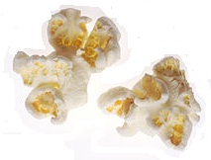
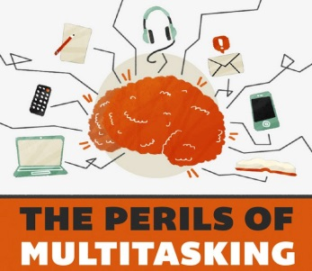
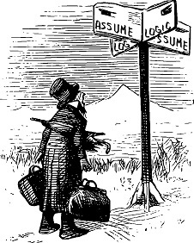
Creating a document plan
Helps you stay on track | Identifies missing research | Identifies problematic logic or assumptions before you start to write | Prevents writer’s block
Source: Wikimedia Commons
OnlineCollege.org
Drew Coffman
Source: Open Clip Art
Planning the Paper
Notes:
I’m going to demonstrate one approach to creating a document plan. By no means is what I’m going to show you the only way to create a plan, so feel free to use and adapt the process as you wish. Whether you use a concept map as I’ll show you, a traditional outline, a pyramiding approach, sticky notes on a wall, or some other approach, the important consideration is that your plan must make sense to you. Each person’s approach to planning is likely to be a little bit different because people think and interact with information in different ways. When you’re deciding what approach to use, think about how you like to organize your thoughts when you’re at work, or doing something as normal as creating a shopping list to take with you to the grocery store. Then, try to adapt that preference to planning your academic work.
Students are often tempted to jump right into the writing process without taking the time to create a plan; however, writing an essay without a plan in place is equivalent to walking into a room to do a verbal presentation without first thinking about what needs to be said and how it should be said. If you’re writing without a plan, you’re ad libbing the message, which means that you’re relying on the best and most appropriate information coming to you in the moment that you need it. It would be great if our brains worked that way, but it seldom happens that a polished message appears without some thought going into it first. On this slide, I’ve provided four reasons why I think having a plan is important:
First, having a plan helps you to stay on track in your discussion. I spoke earlier in this video about the importance of making your discussion easy for someone else to understand, and I’m coming back to that point here. If you don’t plan through how you need to present your ideas so that someone else can understand the story that runs through them, you might end up with “popcorn thoughts”, which your reader will experience as loosely-connected random thoughts, rather than your reader being able to see and follow the structure of your discussion. Popcorn thoughts require the reader to interpret the structure because the connections between the ideas aren’t clear, and whenever a reader has to interpret information, rather than it being provided for them, there is an opportunity for misunderstandings and a break in the flow of the document. It’s easy to get distracted by a new popcorn thought while you’re in the process of writing, but having a plan in place means that you can check that thought against your plan and decide if it fits. If the idea fits, you can also think through where the thought should be included in your discussion so that it serves to achieve the goals of the work, rather than the thought distracting you and your reader away from the key information in your discussion.
Next, having a plan will allow you to check if you have all the necessary evidence before you start to write. Planning a document to the level of what information will be provided in each body paragraph allows you to identify the claim, evidence, and analysis in each paragraph, and how your ideas will connect. It’s a frustrating process to have to flip back and forth between researching and writing because your brain has to do totally different actions. Researching involves locating, evaluating, and making connections between the new information and your existing understanding. Writing, however, requires the expression of ideas so that someone else can understand your thinking. If you’re frequently flipping back and forth between those activities, you’re likely to end up with writer’s block and a great deal of frustration because you’re trying to multi-task. Studies have shown that multi-tasking doesn’t actually work that well; in fact, a person who switches between tasks may be as much as 40% less productive than if they had stayed focused on a single task (Meyer et al. as cited in American Psychological Association, 2006, para. 8). Ensuring you have the research you need in the planning stage means that when you move to the writing stage, you’ll be able to stay focused on the single task of expressing your thinking. That focus should help you to have a less frustrating and consequently more successful writing experience.
My next argument is that having a plan allows you to identify jumps in logic or assumptions of understanding before you start to write. If the plan for your work only exists in your head, it’s nearly impossible to think about your discussion from someone else’s perspective, yet that’s exactly what you need to do when you’re checking if you’ve left out explanations or connections. If you have a plan, you can literally step back from it to look at the plan objectively. Also, you can share your plan with someone else, ideally someone who isn’t in the course or your field of study, and ask that person if your plan makes sense. If your reviewer has difficulty understanding the plan because they can’t tell you what your essay will be about, or isn’t able to understand how you’ll be connecting ideas within or between paragraphs, there’s a good chance that your essay will also be difficult to understand. It’s much easier to identify and address problems at the planning stage than after you’ve finished writing when making changes may require major edits.
Finally, having a detailed plan can help you to overcome writer’s block. Writer’s block happens to everyone, and it isn’t an indication of your overall ability. If you experience writer’s block, there are a few different things that you can try to get through it. Try getting up from your computer and walking away to give your subconscious some time to work with the problem while you’re doing something active. You may find that by the time you return to your computer, you have the solution. Another excellent method of working through writer’s block is to talk out your essay with someone who is prepared to be an active listener. If you explain what you’re talking about and where you’re getting stuck, your conversation partner may be able to ask you questions, such as “what does that mean?”, “why is that important?”, or “how does that idea connect to your focus?” that will help you to move past your block. Having a document plan also helps with writer’s block because you’ll always know what you want to say in any part of the essay, so if one section isn’t working for you, you can instead focus on another section of the document. Also, having a plan means you don’t have to write your document sequentially in one sitting; rather, you can write different sections at different times in whatever order works for you. Being able to continue writing means you don’t need to worry about finishing your document on time. That kind of worry only adds to writer’s block, but by having a plan, you’ll have the flexibility to move around in the document.
I hope I’ve convinced you of the value of having a document plan; for more information, please click on Planning the Paper.
Reference
American Psychological Association. (2006, March 20). Multitasking: Switching costs. Retrieved from http://www.apa.org/research/action/multitask.aspx

Slide 11
1. Choose topic and brainstorm ideas
Returning learners
Gardens
Peacocks
Royal Roads University
Online & F2F learning
Focus on teamwork
Applied programs
Notes:
The first step in developing a plan is to choose a general topic and start brainstorming ideas. If your instructor has given you a specific topic that you should focus on, use that topic. Brainstorming is important because it gives you the opportunity to identify what you already know on the topic. Students often under-estimate how much they already know about a topic and instead jump immediately into doing research. The problem is that as soon as you start doing research, all you’ll be able to think about are other people’s ideas. You probably know more than you think you do, thanks to your course discussions and readings, as well as your life experiences, so give yourself an opportunity to draw on that knowledge. Since the focus of your essay should be your thinking, identifying what you already know is a good place to start. Remember that your essay isn’t supposed to be an exhaustive introduction to your topic; rather, the essay is your opportunity to share the story of your thinking on the topic, which means that you’re the expert. No one else knows your thinking as well as you do, and starting off with a brainstorming exercise allows you to identify what you already know. In identifying existing knowledge, you can also identify what you need to know more about in order to address the scope of the essay, which will give you a direction for your research. On this slide, you can see that I chose Royal Roads University as my general topic, and I’ve started to brainstorm.

Slide 12
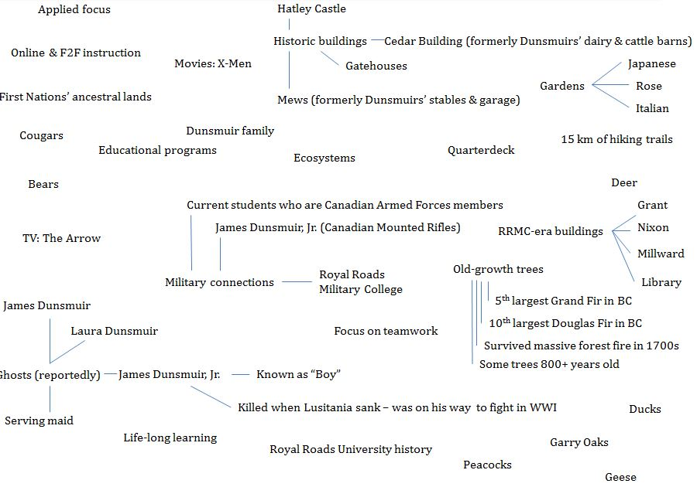
Brainstorming
Royal Roads University: Brainstorming
Notes:
One of the keys to brainstorming is to let your brain wander where it wants as you’re thinking about ideas. On this slide, you can see that my brainstorming about Royal Roads went in a lot of different directions, some of which might not be appropriate for an academic essay. However, it’s important to turn off the vetting function of your brain while you’re brainstorming because you never know how ideas might connect. For example, when I thought about Hatley Castle, it brought to mind the ghosts of James Dunsmuir, Laura Dunsmuir, James Dunsmuir, Jr., and a serving maid who worked for the Dunsmuirs who reportedly haunt the castle. The Dunsmuirs are significant figures in the history of Hatley Park, so while the ghosts aren’t likely to be discussed in my essay, the Dunsmuirs are a relevant connection. Also, James Dunsmuir Jr. was sailing on the Lusitania on his way to fight in World War I but was killed when the Lusitania was sunk, which gives me a connection between the Dunsmuirs and the Canadian military. Royal Roads University has a significant past and present connection to the Canadian military, so that connection is relevant to my topic.
If you’d like to take some time to read all the items on this slide, please pause the video and then press play when you’re ready to proceed. Now that I’ve finished my brainstorming, I need to decide what I’m going to do with all this information, which leads me to the next step.

Slide 13
2. Draft your thesis statement
Create a specific thesis statement that outlines the focus and boundaries of the story you’re telling:
Can be one or two sentences long
Think about how you would finish the sentence: “In this essay, I will…”
E.g., In this essay, I will demonstrate that Royal Roads University is unique amongst post-secondary institutions on Vancouver Island because of its history, Hatley Park, diversity of wildlife, and educational programs.
Thesis Statements/Research Questions
Notes:
The thesis statement is one or two sentences that establish the boundaries of your discussion. Ideally, your reader should be able to decide whether to read your paper after reading the thesis statement. The thesis statement is also helpful to you because it can help you stay focused on the story you’re telling in the essay. One approach to writing a thesis statement is to complete the sentence: “In this essay, I will…”. On this slide, you can see an example thesis statement: Royal Roads University is unique amongst post-secondary institutions on Vancouver Island because of its history, Hatley Park, diversity of wildlife, and educational programs. You might notice that my thesis statement is specific – I’m signaling to my reader exactly what I intend to demonstrate within the essay, which also gives me a direction to follow in my discussion. If you’re finding it hard to start writing an essay, often the reason is a missing thesis statement, or a statement that is too broad. For example, if my statement said “Royal Roads University is unique”, I would then have to prove that Royal Roads is unique compared to everything, everywhere, ever. I wouldn’t know where to start with making that argument or researching that topic! However, in my thesis statement, I’ve put limitations on what I’m going to discuss, which is that RRU is unique compared to other post-secondary institutions, on Vancouver Island, and in the 4 identified categories. With those limitations in place, I know exactly what I need to demonstrate, and any information that doesn’t fall within those parameters isn’t relevant.

Slide 14
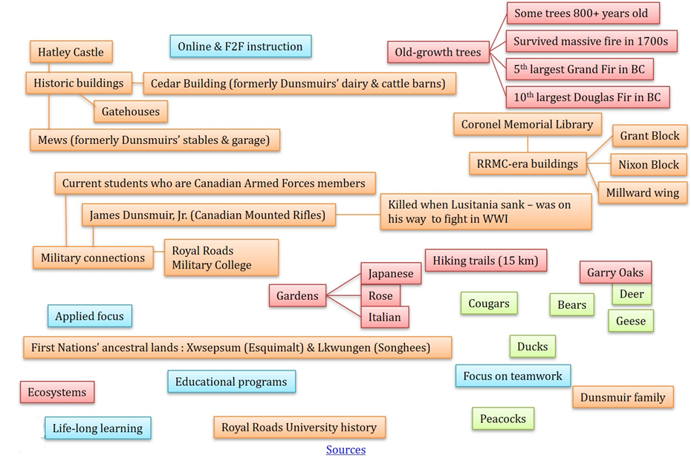
3a. Use thesis statement to edit and group ideas
Royal Roads University is unique amongst post-secondary institutions on Vancouver Island because of its history, Hatley Park, diversity of wildlife, and educational programs:
Notes:
Now that I have my draft thesis statement, I can go back to my brainstormed ideas to decide what I’m going to do with them. You’ll see that I’ve started to group my ideas, and I’ve used colours to identify which ideas are connected to others. I have also removed some details because I decided they weren’t relevant to the purposes of this essay. If you would like to see where I verified my information, please click on Sources.

Slide 15
3b. Use thesis statement to edit and group ideas
1. History
First Nations’ ancestral lands
Dunsmuir family
Military connections
Royal Roads University
2. Hatley Park
Old growth trees
Unique ecosystems
Gardens
Hiking paths
3. Diversity of wildlife
Cougars
Bears
Birds
Deer
4. Educational programs
Life-long learning
Online & F2F instruction
Focus on teamwork
Applied focus
Notes:
This slide shows the beginning of what I did in the last slide, but I’ve used a different approach. The previous slide used a concept mapping approach, whereas here I used a linear approach. It doesn’t matter which approach you use, as long as you use one that works for you.

Slide 16
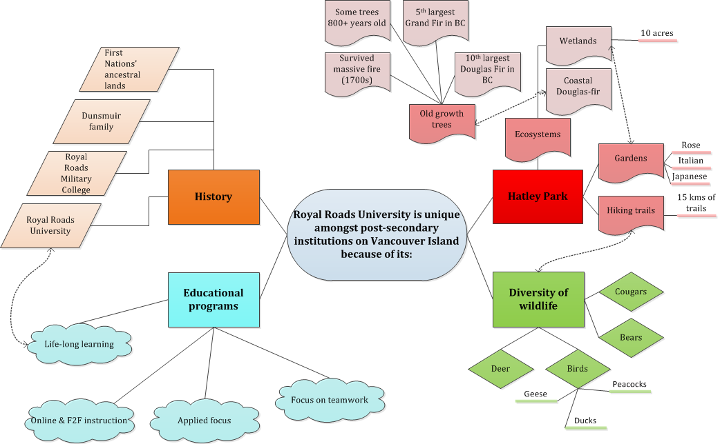
4. Create the plan
Sources
Notes:
Here is the beginning of my plan. I’m using a concept map, but you could do the same thing using any other form that works for you. You’ll see that my thesis statement is at the centre of the map, and my four main claims branch off it. I’ve started to branch off those points into my sub-claims on the right side of the map. If you look at “Unique ecosystems”, you’ll see that I have new information that I didn’t have in my brainstorming, which is that two of the ecosystems found on campus are the 10 acre wetlands and a Coastal Douglas Fir zone. That information is an example of how identifying what I already knew in the brainstorming exercise allowed me to identify what I needed to know more about. I knew we had ecosystems, but I didn’t know what they were. After I did more research, I was able to fill out my map further to accommodate the new information. If you would like to see where I verified my information, please click on Sources.
I also have dotted lines connecting different sections of the map. Those lines indicate how I will transition from one part of my map to another; for example, my connection between “Old-growth trees” and “Ecosystems” is that the old-growth trees on campus are part of the Coastal Douglas-fir ecosystem. Since I have planned that transition, I know I won’t forget to include it in my essay, which means that my reader won’t struggle to understand how I’m moving between those two sections.
As I mentioned at the start of this slide, your plan can take whatever form works for you. This plan is a concept map, but to see a linear outline, please move to the next slide in this video.

Slide 17
Linear outline
Introduction
Includes thesis statement
II. Body paragraph A
Claim, evidence, analysis
III. Body paragraph B
Claim, evidence, analysis
IV. Body paragraph C
Claim, evidence, analysis
V. Conclusion
Say what you’re going to say
Say it
Say what you’ve said, what you’ve learned, and why it’s important
Paragraphs & Finalize Your Document Plan
Notes:
Here is an example of a traditional outline, and while it may appeal more to linear thinkers than a concept map, both formats do the same thing in allowing an author to plan their thinking. You may have learned about this formatting in an English class as it’s the traditional 5 paragraph essay, but it can be adapted for a shorter or longer essay. In the introduction, say what you’re going to say, including your thesis statement. In the body paragraphs, demonstrate your critical thinking through providing your claims, evidence, and analysis. In the conclusion, say what you’ve said, what you’ve learned, and why it’s important. Think about your conclusion as your last opportunity to make an impression on your reader – what would you want your reader to remember about your discussion?
Whether you’re using a linear outline, a concept map, or another form, my suggestion is that you plan to the level of what information you’ll provide in your paragraphs so that you have that level of thinking mapped out. After all, it’s the body paragraphs that communicate the key information in the story you’re telling, so leaving that writing unplanned significantly increases the chances of problems happening at that level. For more information on academic paragraphing, including writing introductions and conclusions, please click on Paragraphs. Please click on Finalize Your Document Plan for a template to assist you with your planning. The template is also available as a Word document from that link, and you’re welcome to adapt the information for your purposes.

Slide 18
Qualities of academic writing
At RRU, academic writing:
Shares the story of your understanding of the topic
Often an in-depth analysis with an evidence-based approach
North American academic English prioritizes language that is clear, concise, and easy to understand
Avoids assumptions of reader knowledge or experience
Demonstrates the outcomes of the assignment
Consistently and correctly follows the APA Style rules; see APA Style (7th ed.) for more information
Notes:
This slide brings us back to where we started, and I hope this video has given you useful information on the qualities that will be expected in your academic writing during your time at RRU. The goal of your writing will be to share the story of your understanding of a topic through providing an in-depth, evidence-based analysis. The means by which you’ll reach this goal if you’re writing for a North American academic audience is using a clear, concise, and easy to understand style that avoids assumptions of reader knowledge or experience. Your essays will demonstrate the outcomes of your assignments, and finally, the work will be formatting to the APA Style rules. As I hope you’ve seen through this video, each one of these qualities is a skill, which means that the more you practice them, the easier they will be. If you’re a Royal Roads student and you would like help with learning these skills, please contact the Writing Centre - you’ll find the contact information for the Writing Centre on the next slide.

Slide 19
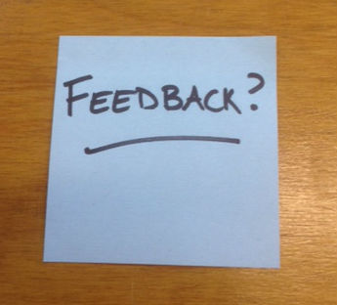
Contact the Writing Centre
http://library.royalroads.ca/writing-centre
http://writeanswers.royalroads.ca
(250) 391-2600, ext. 4353
Notes:
We’ve reached the end of this video. If you’re a Royal Roads student and you have questions about the content of this video or any other matter related to academic writing, please contact the Writing Centre so that we can assist you. If you would like to provide feedback about this video, please click on the “Feedback” image.
Thanks for watching!

